Slide 1
Branding
And why it matters.
Communications and Marketing Committee
Notes:
On average, a person sees or hears over 3000 commercial messages every day. So without even realizing it, you see (and easily identify) brands all the time. So what exactly is a “brand”?

Slide 2
What is a “brand”?
  All organizations have something called a “brand.”
  It’s the unique way they stand out in the marketplace.
  A brand encompasses logo symbol, logotype, colors, fonts, and anything representing that business.
Notes:
If you’ve ever been on a cattle ranch, or watched old time western movies, you know exactly what a brand is! It’s really the same thing, how to identify that something belongs to something/someone with just a glance.
What do you think of when I say “swoosh” or “just do it”?
Nike – they hope! That logo has been around since 1974! There’s a reason big company’s spend millions of dollars and work very hard for that immediate “ah, that’s who that is” reaction.

Slide 3

A few famous brands
Notes:
Story about Coke – cease and desist letter because someone wasn’t using the “Coke red”

Slide 4
From Our Collaborative Partners
Notes:
Neither Lions or Kiwanis has changed since they began – their clubs don’t change it either!
Rotary has changed but see how small the differences are? And again, clubs use these logos with their club names as appropriate.

Slide 5


Which one is right?
Notes:
Meow?
Starbucks is a franchise. Think what would happen if a new franchise owner changed the logo because they wanted to? Not only would the Corporate (aka Parent) Company sue them to stop, the franchisee would lose all the name/brand recognition they just purchased.

Slide 6
Which one is right?
Notes:
People get comfortable with something, and they don’t like change. Coke tried “New Coke” and people freaked out.

Slide 7

This is our brand identity
Mission:
By providing hope and positive vision, Optimists bring out the best in youth, our communities, and ourselves.
Brand Promise: Optimists bring out the best in our youth, our communities, and ourselves.
Slogan: Friend of Youth.
Tagline: Bringing Out the Best.
Notes:
As members we know and understand our mission – bring out the best in youth, our communities and ourselves. But we don’t always do a great job of ensuring that non-optimist’s easily recognize the world wide organization that is Optimist International.

Slide 8

Our most visible brand asset
Notes:
Our most visible brand asset is our logo. Whether club, district, region or International – our logo is what readily identifies us to each other and to the general public.

Slide 9








Brand Identity Crisis
Notes:
This is what’s currently out there – do you wonder why people don’t recognize who we are? This is a big reason why Optimist International is the best kept secret. Our mission is not clear because our logo is not cohesive.
People need to see something 11-13 times before they recognize it. Imagine what happens when your community sees a different logo with every event you do?

Slide 10
Brand Identity Crisis
Optimist
Optimist
international
International
Optimist
Optimist
International
International
Optimist
Optimist
International
International
Notes:
Not just the logo – but how we use whatever color, font or style we think is “cool” or “fun” really does a disservice to our brand.

Slide 11
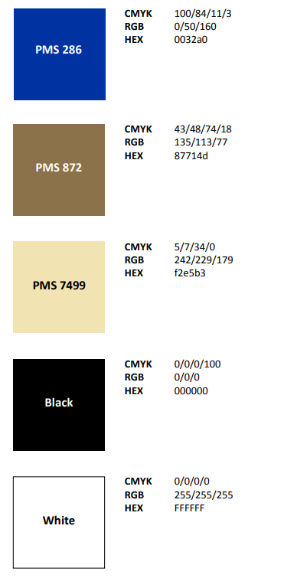
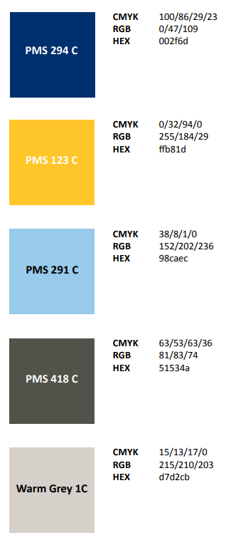
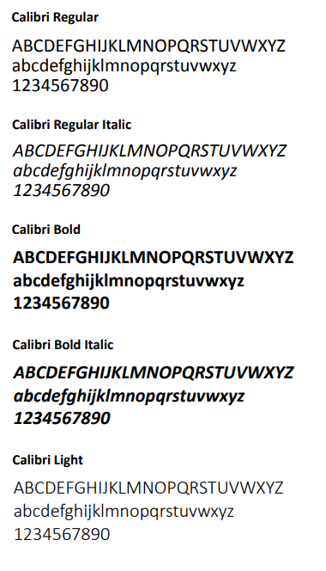
Brand Colors and Fonts
Primary Color Pallet
Secondary Color Pallet
Primary Font Family
Notes:
Like our logo, our colors help to clearly identify who we are AND create cohesion within our LARGER organization.
There are a myriad of ways to combine these colors so this is where you can be a little creative.

Slide 12
Brand Logo
Standard Horizontal Version
Stacked Version
Roundel Version
Notes:
Horizontal
Stacked
Roundel
*** when using the logo – for whatever purpose - think from the perspective of someone who has never been exposed to Optimist International. Is it easy to read? Is it easy to see? Is it easy to understand?
These logos were deliberately created to fit every situation – tshirts, pens, cups, paper handouts, vinyl, etc.
And also to clearly identify which level of OI they are associated with – club, district and international.

Slide 13
Standard Horizontal
International
District
Club
Notes:
The horizontal version of the logo is the standard and is the best option for letterhead, business cards, envelopes, and general use where adequate horizontal space can be afforded.
POINT OUT – international, district, club

Slide 14
Stacked
International
District
Club
Notes:
The stacked version of the logo is best utilized for vertical applications, centered layout, and areas where there is limited space.
POINT OUT – international, district, club

Slide 15
Roundel
International
District
Club
Notes:
The roundel version of the logo is for use on T-shirts, uniforms, specialty advertising items, pins, banners, and signage.
The roundel is fine for a banner but if you find yourself having to spell out the club name in addition to the roundel consider using the standard or stacked logo that already has your club name included.
POINT OUT – international, district, club
Use this for your Facebook business profile picture – imagine almost 3000 OI logos on Faceobok? Wow!

Slide 16


Incorrect use of logo
Notes:
To reiterate, we deliberately created these to work in a myriad of ways WIHTOUT confusing people who may be unfamiliar with our mission.
There is no reason to change what has been created.

Slide 17

Let the logo “breathe”
Make sure in your layout and designs you leave sufficient space around the logo so that it can be clearly recognized and is not encroached upon by any other elements.
The general rule is that the minimum free space around the logo should be equal to the height of the lowercase letter "s" in "Optimist".
Notes:
We let the logo breathe because we’re proud of who we are and what we represent – bringing out the best.

Slide 18

Use an appropriate background
The logo should be placed on a background which does not interfere with its recognition.
When placing the three-color version of the logo use a white background.
When using a single-color version of the logo make sure to place it on a low-contrast background.
Notes:
There is a reason for the colors and the placement – cohesion and to more easily/readily identify who we are. And what we do.

Slide 19

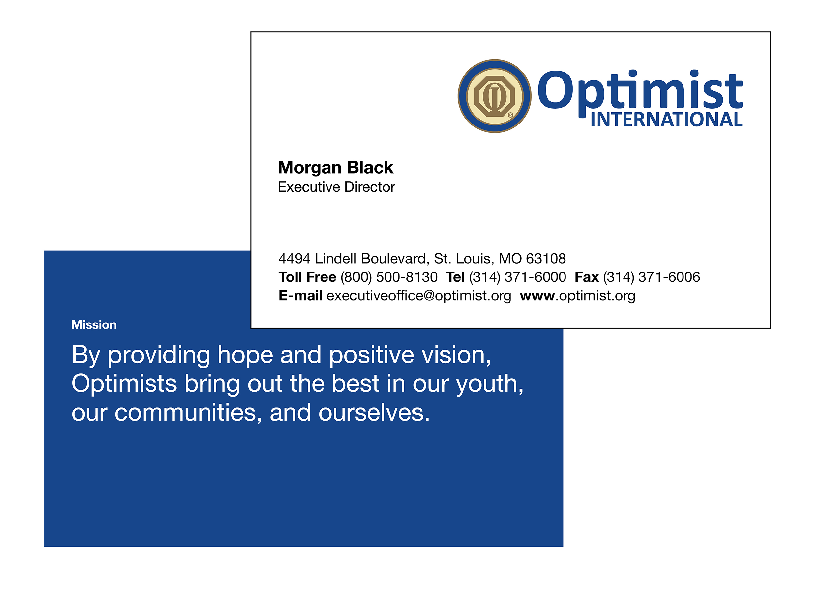
Sample Use
Notes:
You can purchase almost anything with the logo at the ProShop on the Optimist International website (optimist.org)

Slide 20
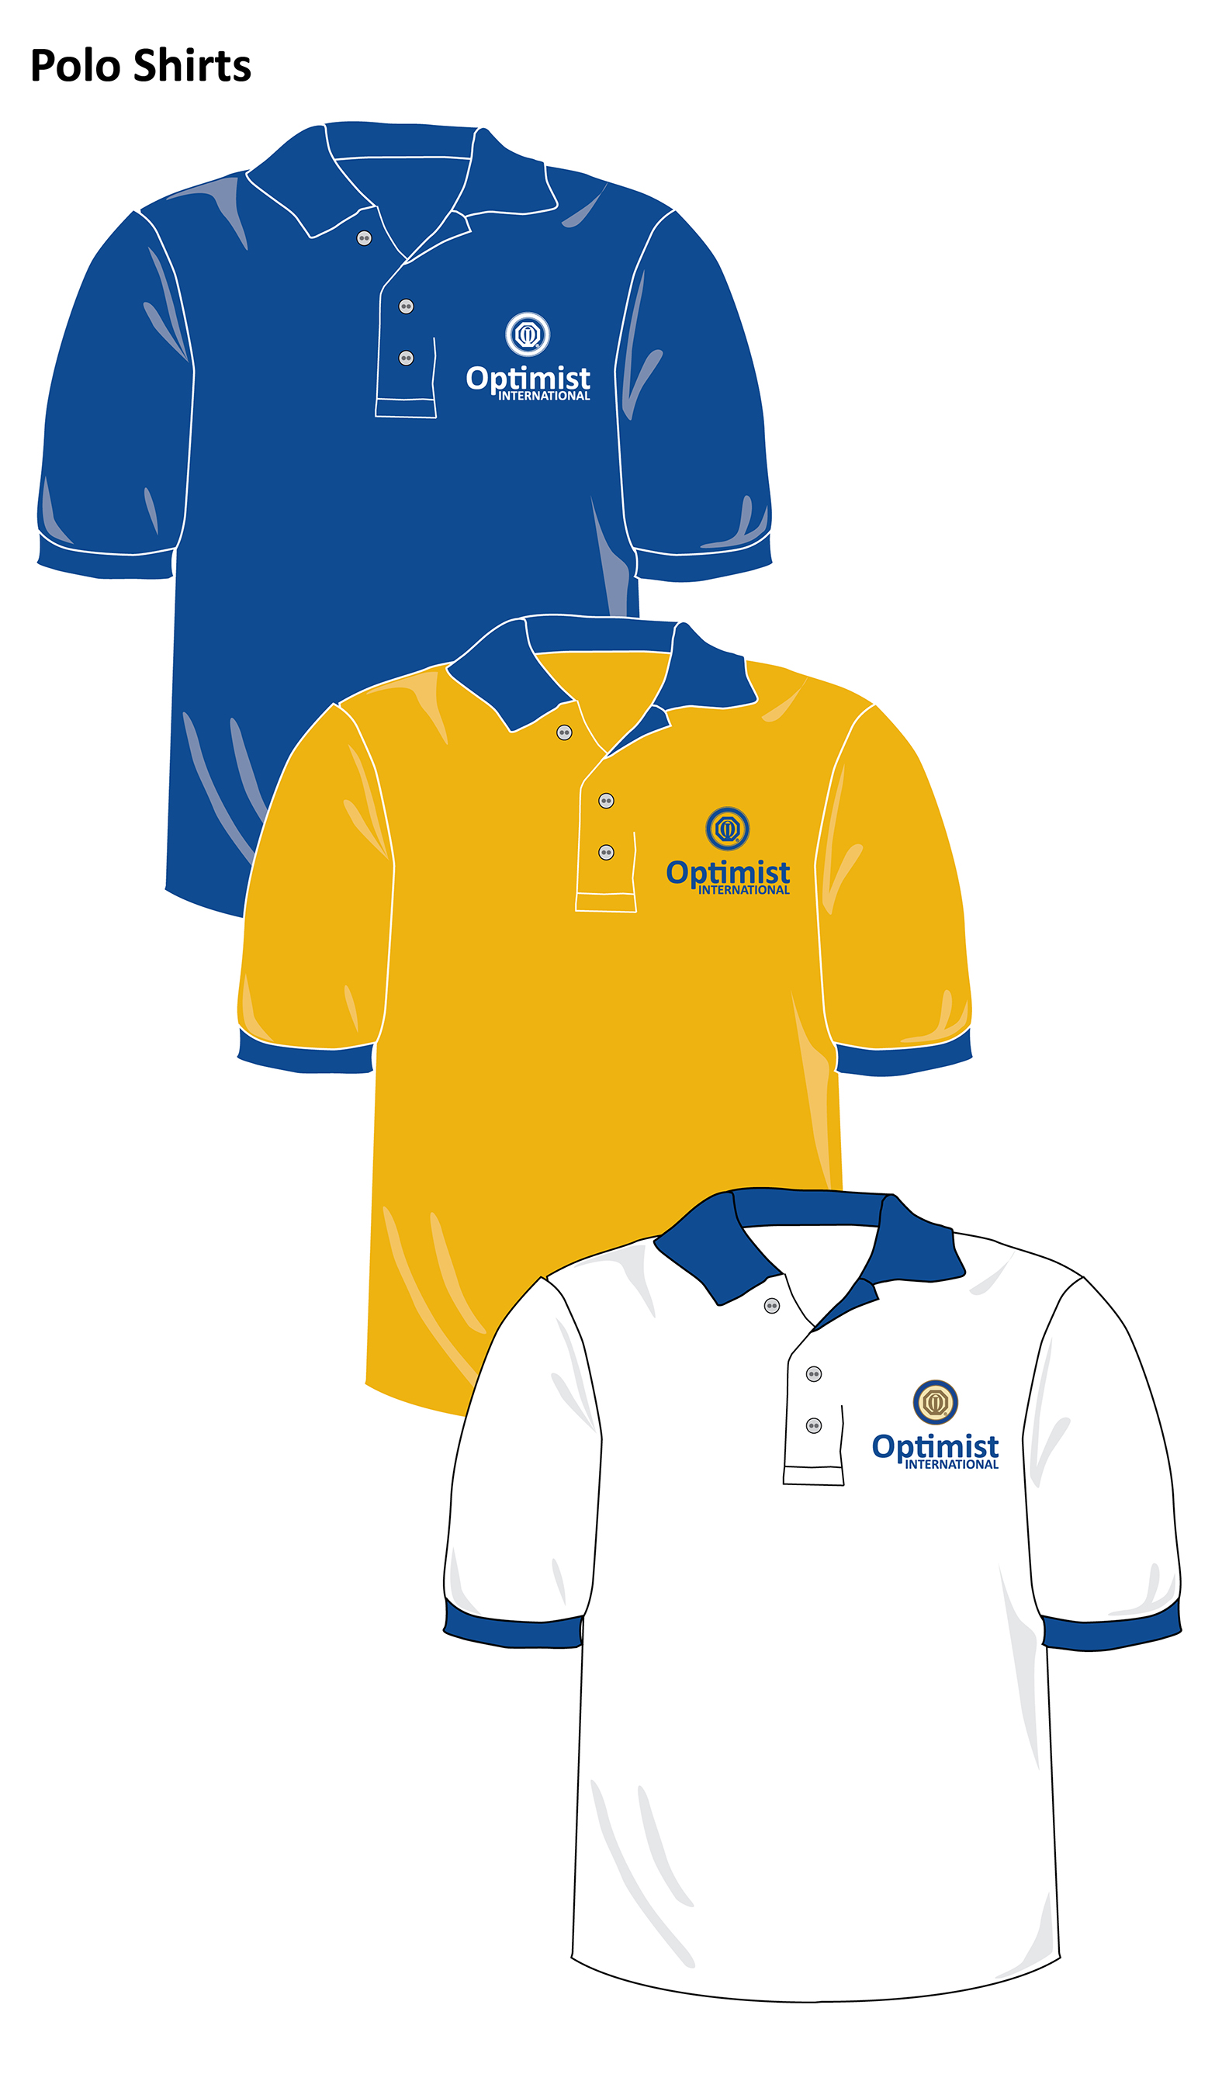
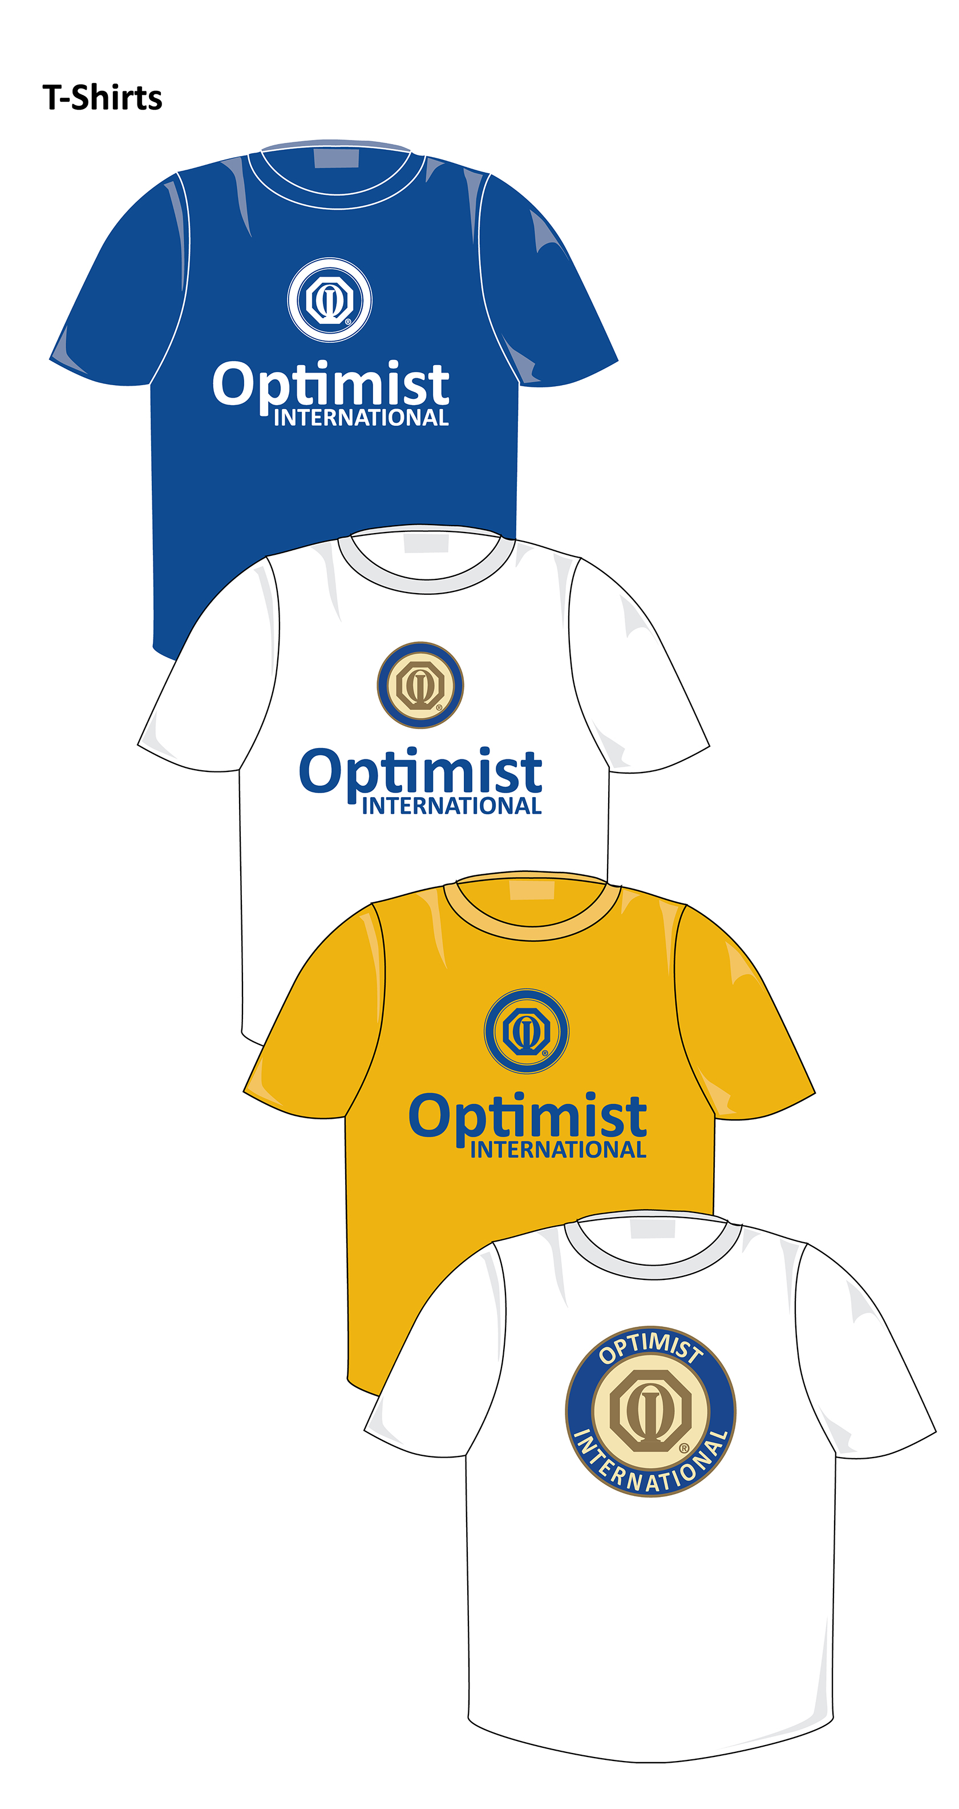
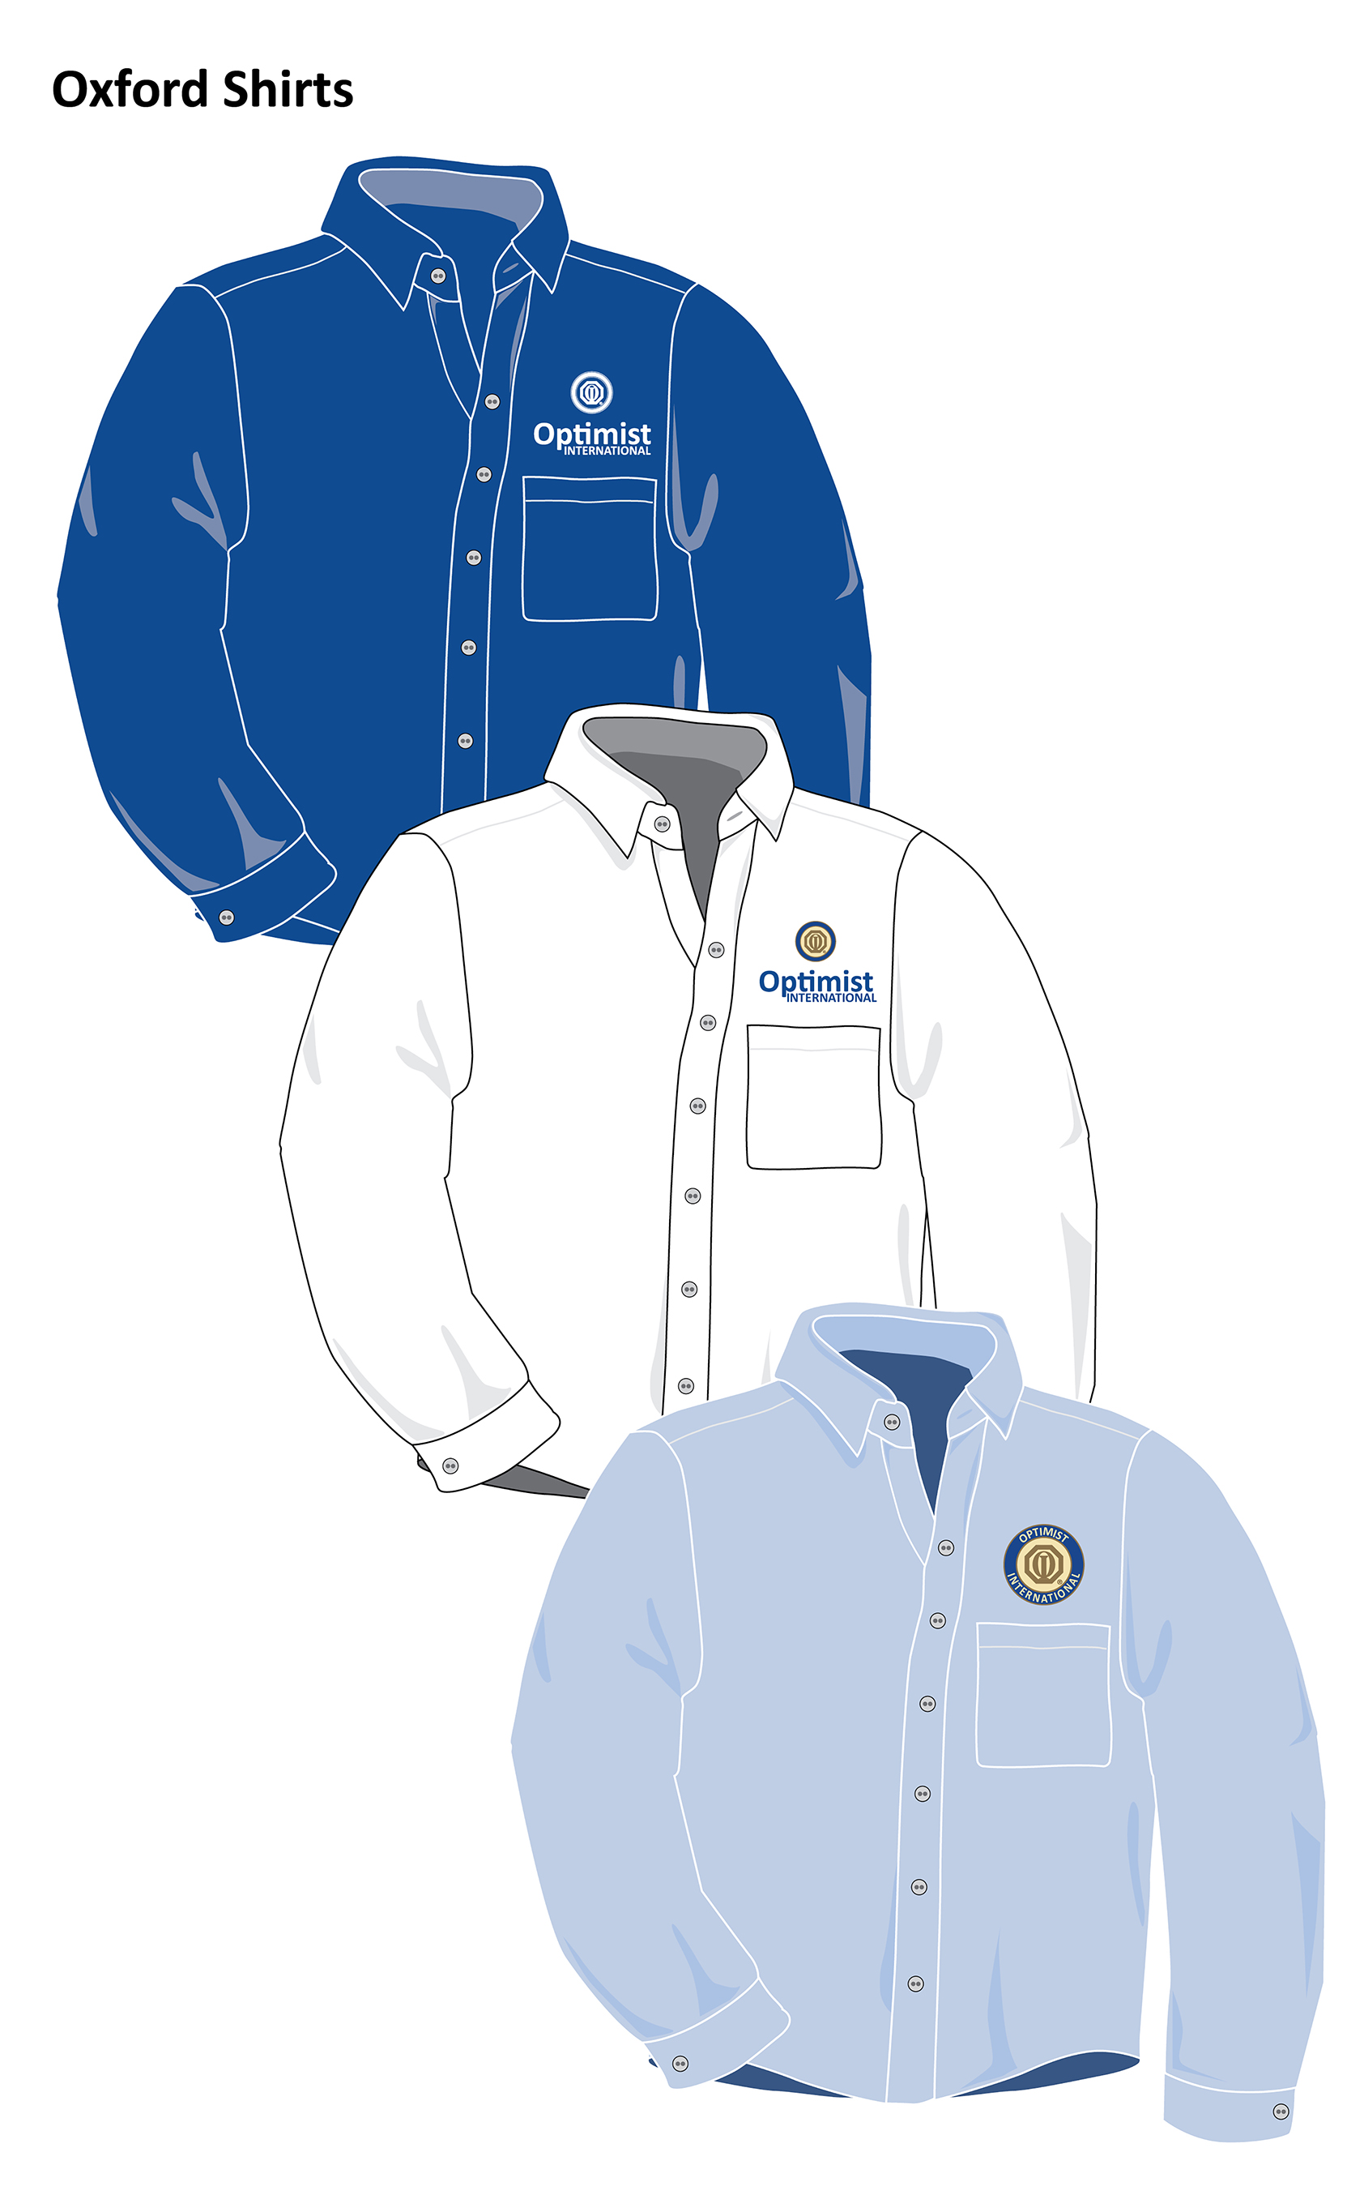
Sample Use – Clothing

Slide 21
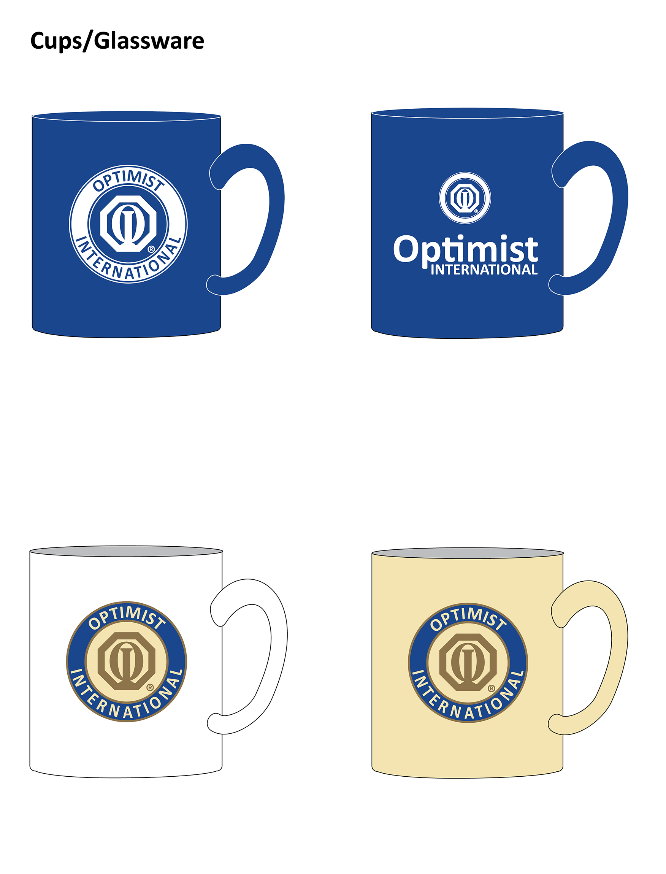
Sample Use – Cups/Glassware

Slide 22
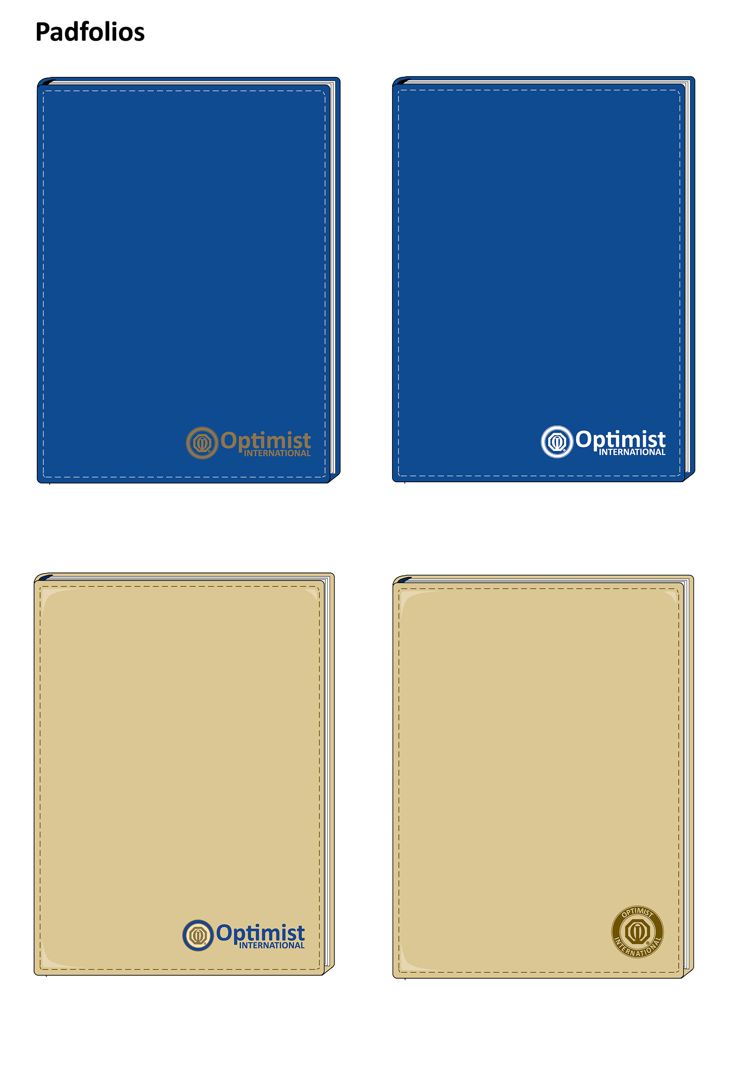
Sample Use - Padfolios

Slide 23
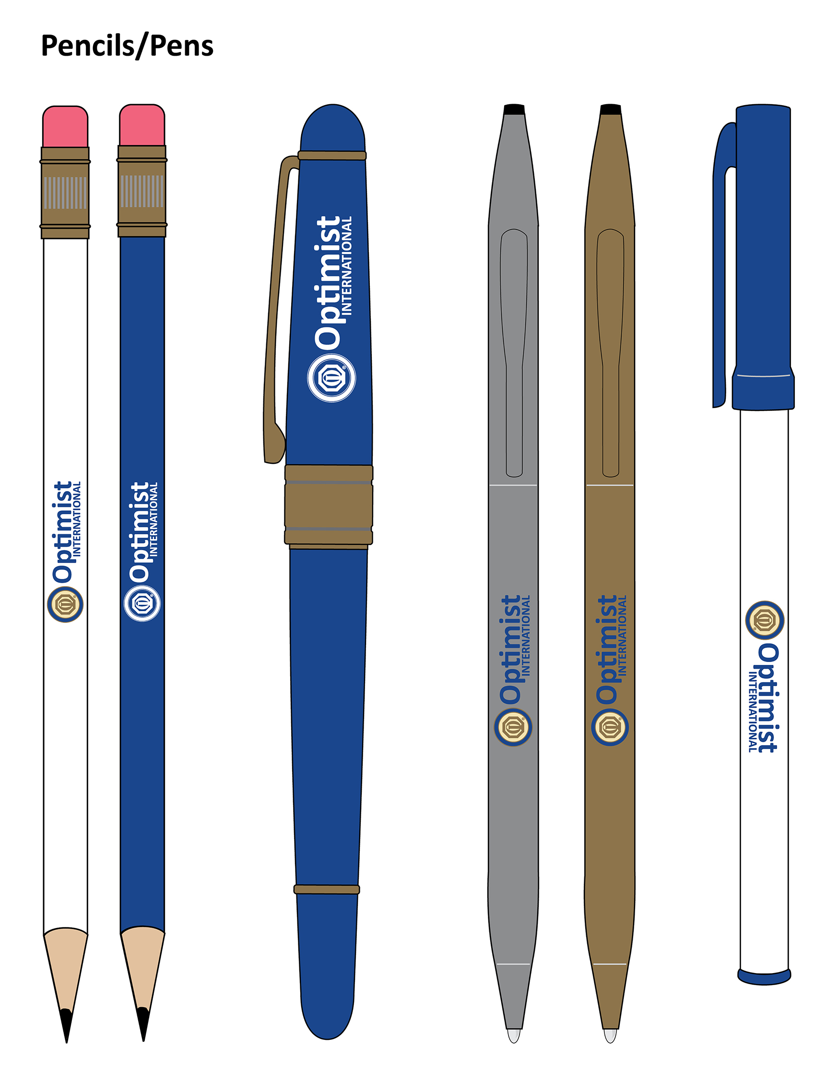
Sample Use – Pencils/Pens
Notes:
Don’t just slap a rondel on a pen/pencil – it won’t show up! This is a perfect place for a horizontal logo. And maybe a website or Facebook page?

Slide 24
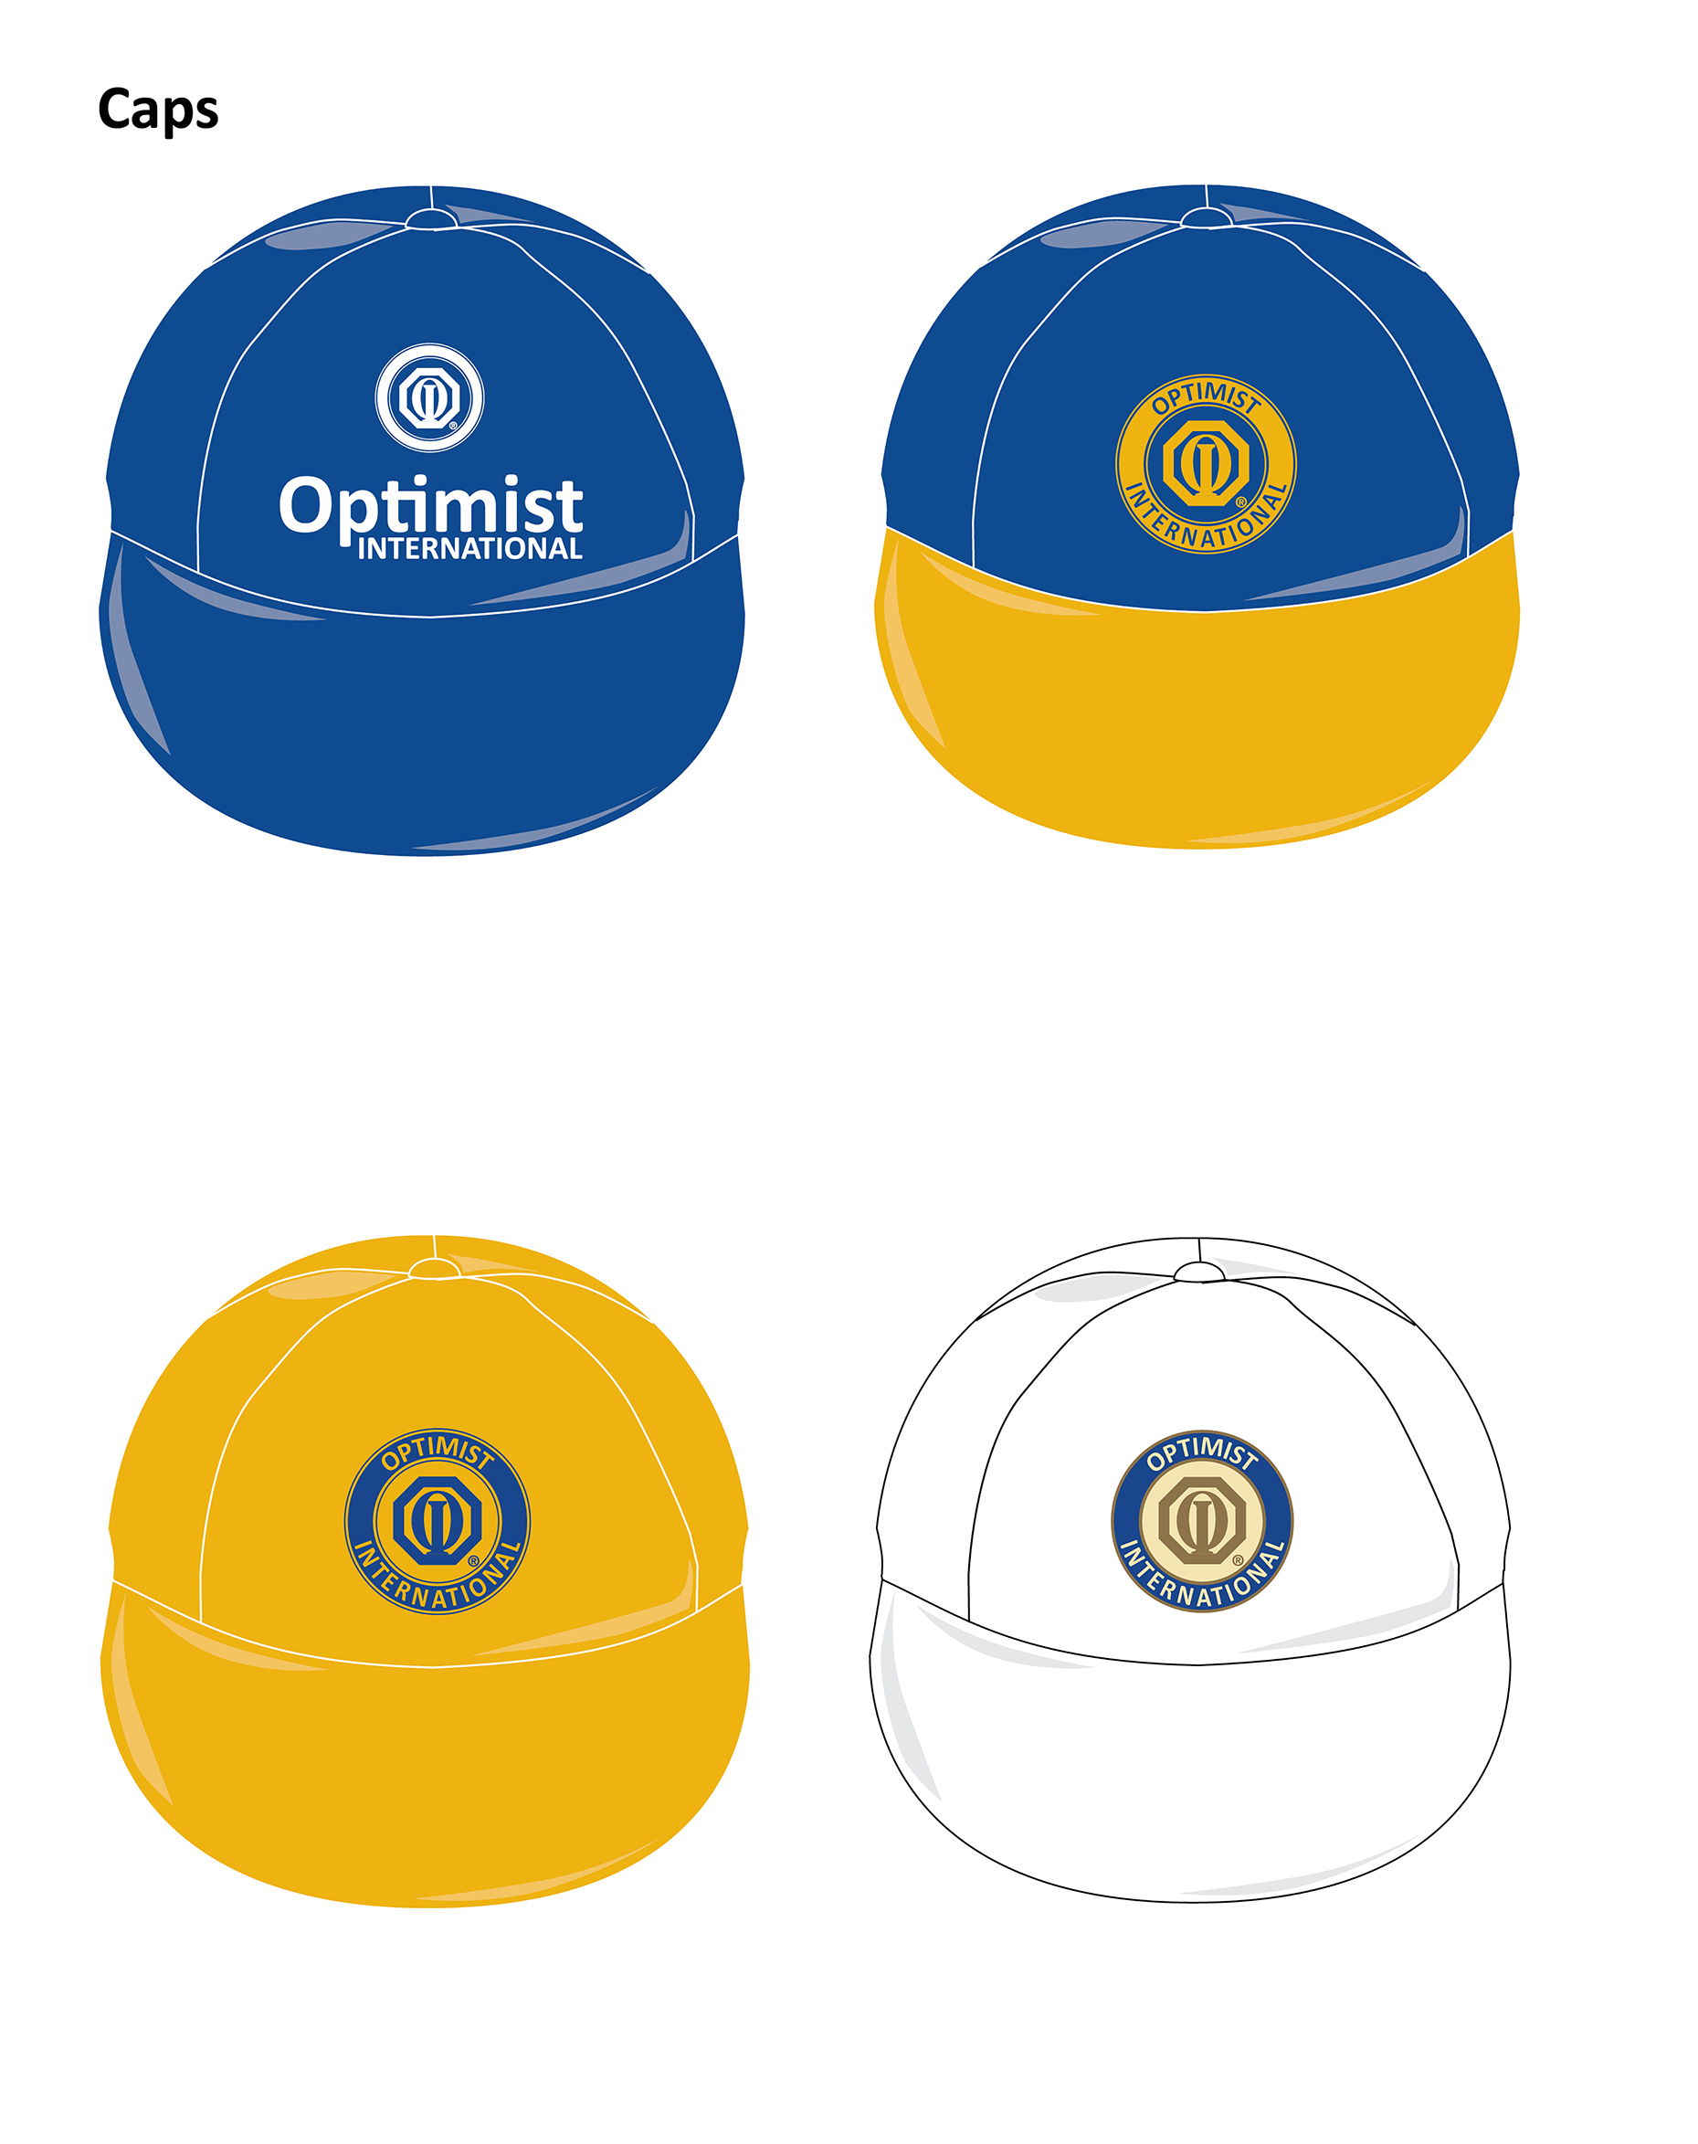
Sample Use – Caps

Slide 25
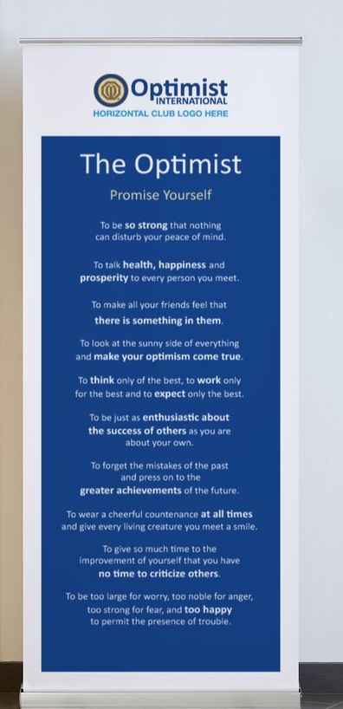

Sample Use – Vinyl
6’x2’ Vinyl Banner (with grommets) Fits 6’ Table
Window Decal (ProShop)
Pop-Up Creed (ProShop)

Slide 26

Sample Use – Misc.
2-1/2” Buttons (10 Buttons, 5 Blue, 5 Beige)
Prospect Sheet
Facebook cover photo
13-1/4”x11” Counter Card with Brochure Holder

Slide 27


Sample Use – Event Promotion
Facebook Event Cover
Facebook Post
Event flyer (pdf)

Slide 28
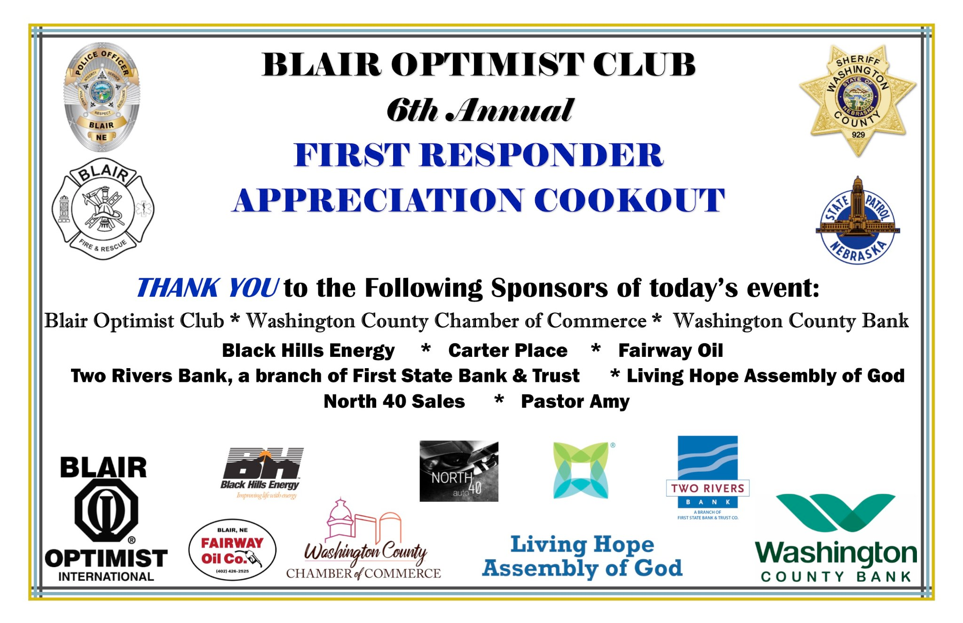
From this …
Notes:
The Blair example is using old branding which has also been altered. Instead use the stacked logo. This version is better for vertical or square spaces. The original logo is ideal for horizontal spaces. Both version are suitable for ease of visibility of the Optimist International name.

Slide 29
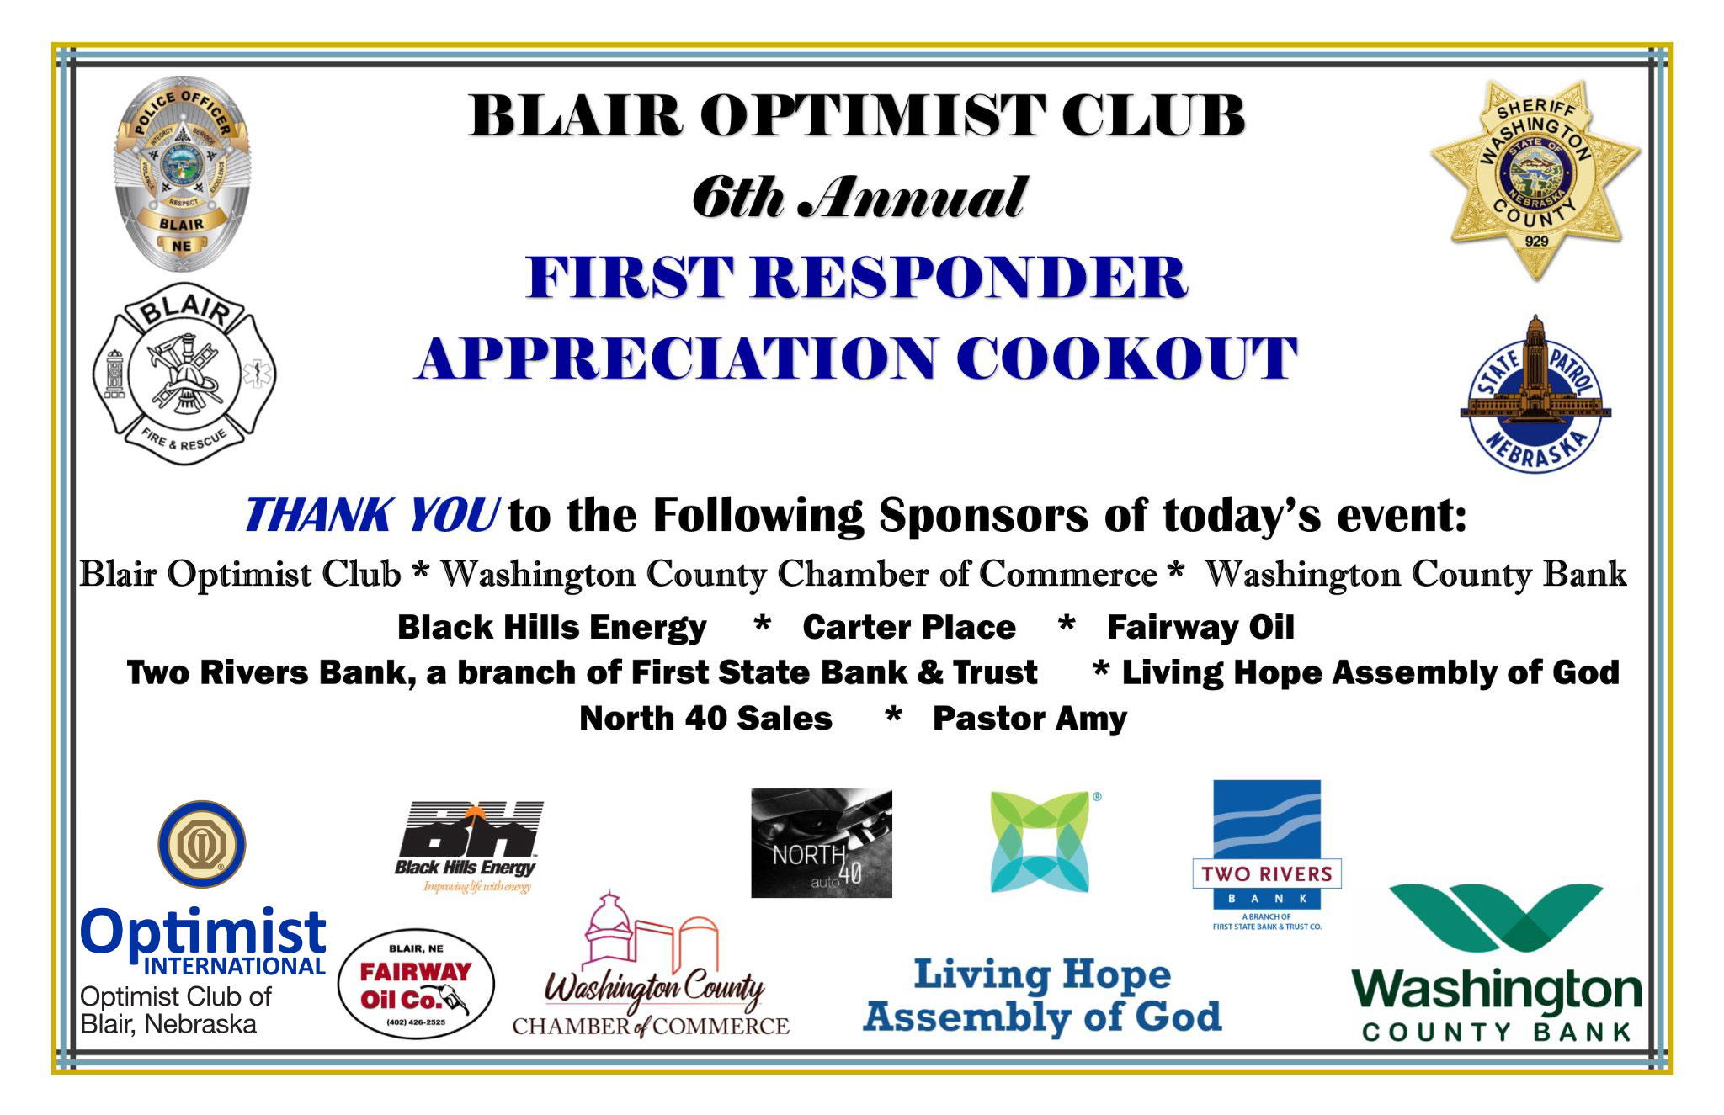
To this:

Slide 30

From this …
Notes:
When using the roundel especially at smaller sizes for example in the Windsor golf poster it becomes merely a blue and gold circle with text being unreadable.

Slide 31

To this:
Notes:
Because even without making the image bigger you can see Optimist.

Slide 32
Is this ”Go” or ”No-go”?
Notes:
See the size of this roundel? We want people to see it easily – no squinting to read anything.

Slide 33
Resources
Find your logos.
Club Logos are on the main Leadership Login Club Roster screen. The EPS/JPG/PNG are different graphic types.
Other logos are here: https://www.optimist.org/member/marketing6.cfm
Brand Guidelines:
Including ALL the information you’ll need plus examples. https://www.optimist.org/Documents/Branding_Guidelines.pdf
Single page “cheat sheet.”
Notes:
https://www.optimist.org/member/marketing6.cfm – optimist.org look for “member resources” tab, then scroll for “marketing” then “logos”
https://www.optimist.org/Documents/Branding_Guidelines.pdf – optimist.org look for “member resources” tab, then scroll for “marketing” then “Branding Guidelines”

Slide 34
Resources
Shop at the Optimist Pro Shop.
Through a partnership with Vistaprint, you can shop at a ProShop for all your optimist needs!
Business cards
Club supplies
  custom buttons/pins
  book markers
  folded note card
Signage
  flags
  table cloth/runner
  bumper sticker
  creed pop-up
  window decals
And more!
Create an account/log-in on optimist.org.
Notes:
https://www.optimist.org/member/marketing6.cfm – optimist.org look for “member resources” tab, then scroll for “marketing” then “logos”
https://www.optimist.org/Documents/Branding_Guidelines.pdf – optimist.org look for “member resources” tab, then scroll for “marketing” then “Branding Guidelines”

Slide 35
Resources
Social Media Downloads (OI branded)
  https://www.optimist.org/member/marketing10.cfm
Facebook Groups:
  OI Marketing https://www.facebook.com/groups/OptimistMarketing
  OI Club and Members https://www.facebook.com/groups/optimistintl
Marketing Request Form on optimist.org
Notes:
https://www.optimist.org/member/marketing6.cfm – optimist.org look for “member resources” tab, then scroll for “marketing” then “logos”
https://www.optimist.org/Documents/Branding_Guidelines.pdf – optimist.org look for “member resources” tab, then scroll for “marketing” then “Branding Guidelines”
Marketing Request Form; https://www.optimist.org/Documents/marketing/Marketing%20Request%20form.pdf

Slide 36
What Do You Want to Know?

Slide 37
Showcase our brand!
Notes:
Our logo is what sets us apart – imagine if ALL the clubs across the world used the same logo? We wouldn’t be the best kept secret any more would we?

