Slide 1


Slide 2
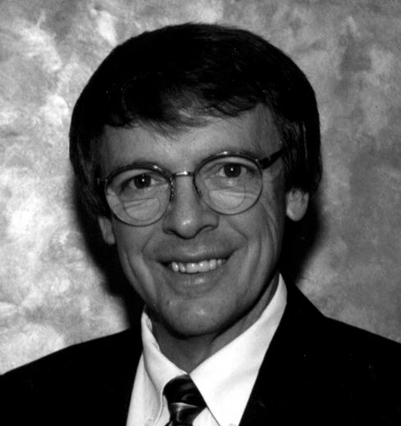
1996-1997
Jimmy Myerholz
Hartwell, Georgia

Slide 3
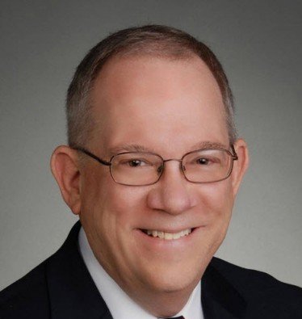
1997-1998
H. Nick Prillaman, Jr.
Atlanta, Georgia

Slide 4
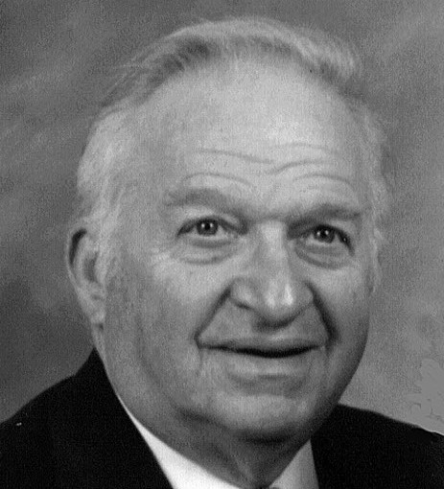
1998-1999
John L. Ware
Conyers, Georgia

Slide 5
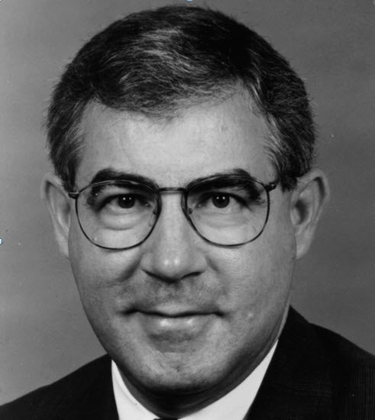
1999-2000
Richard D. Mason, Jr.
Cartersville, Georgia

Slide 6
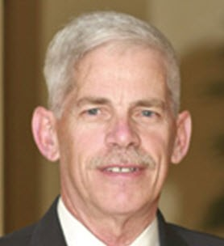
2000-2001
Mark Shriver
Atlanta, Georgia

Slide 7
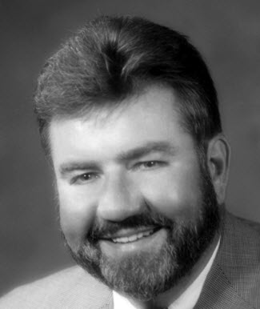
2001-2002
Jim Wolbrink
Atlanta, Georgia

Slide 8
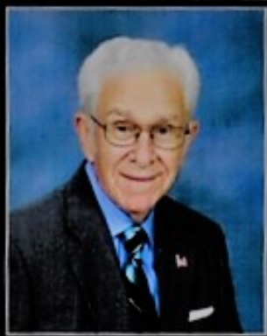
2002-2003
Charles Chandler
Clinton, Tennessee

Slide 9
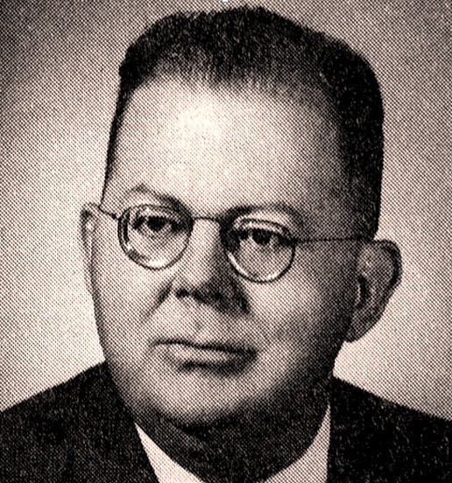
2002-2003
John W. Whatley
Atlanta, Georgia

Slide 10
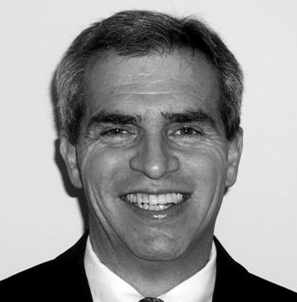
2002-2003
David K. Elster
Fayetteville, Georgia

Slide 11

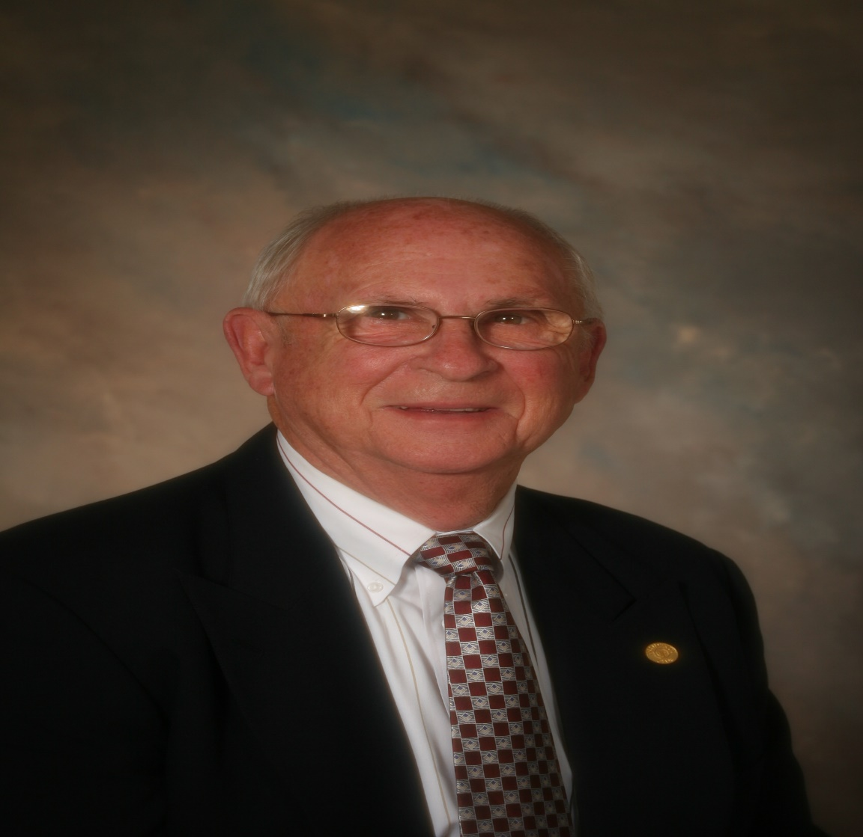
2002-2003
Paul Harbin
Knoxville, Tennessee

Slide 12
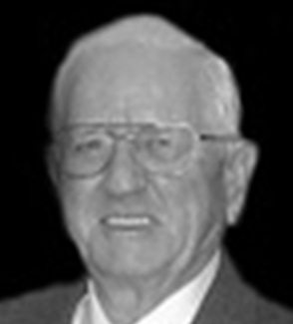
2002-2003
W. B. Perry, Jr.
East Point, Georgia

Slide 13
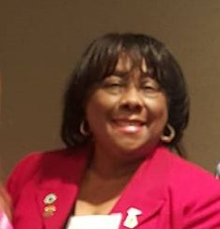
2002-2003
Essie Johnson
Knoxville, Tennessee

Slide 14
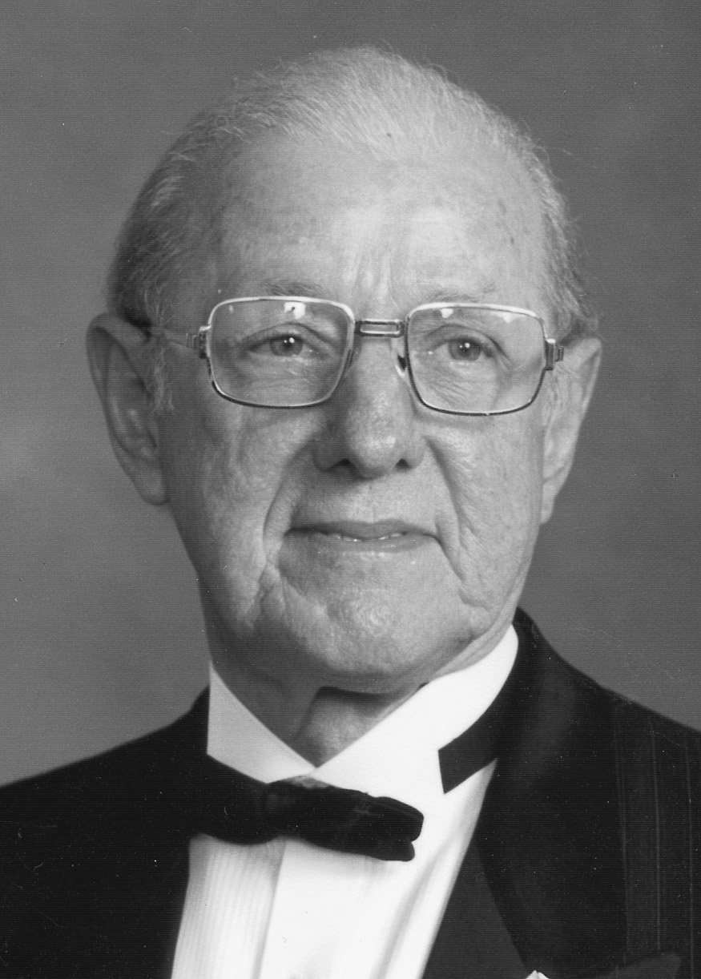
2002-2003
Robert Leonard
Knoxville, Tennessee

Slide 15
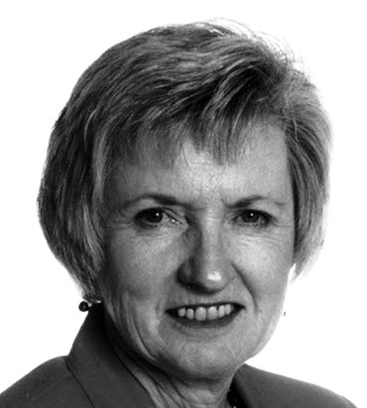
2003-2004
Dorothy Jorgensen
Kennesaw, Georgia

Slide 16
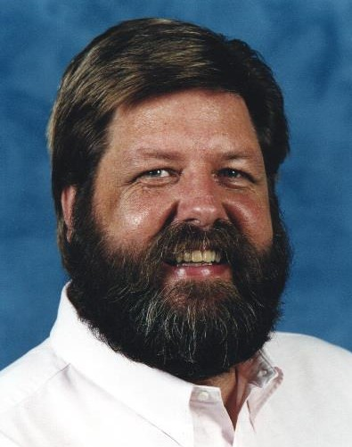
2003-2004
Hal Bell
Kennesaw, Georgia

Slide 17
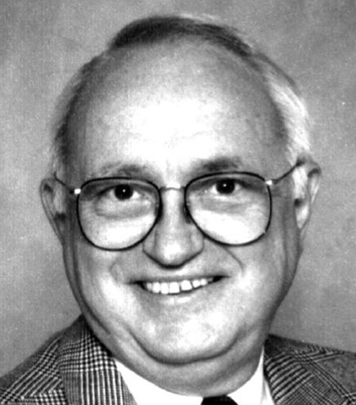
2003-2004
Thomas Eubanks
Jasper, Georgia

Slide 18
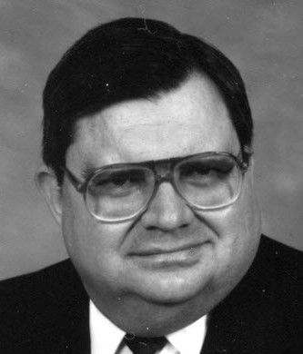
2003-2004
Richard K. Shiver
LaGrange, Georgia

Slide 19
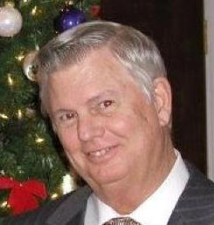
2004-2005
Ralph Eberhart
Roswell, Georgia

Slide 20
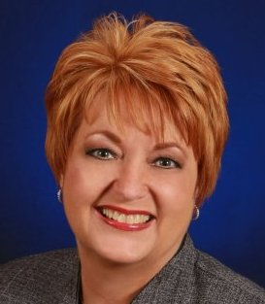
2005-2006
Linda Lee
Savannah, Georgia

Slide 21
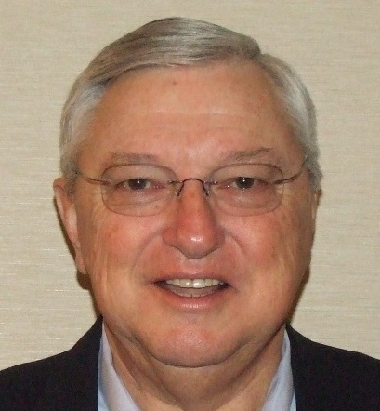
2006-2007
Mark Eubanks
Rome, Georgia

Slide 22
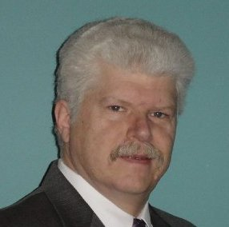
2007-2008
Keith Pruitt
Cumming, Georgia

Slide 23
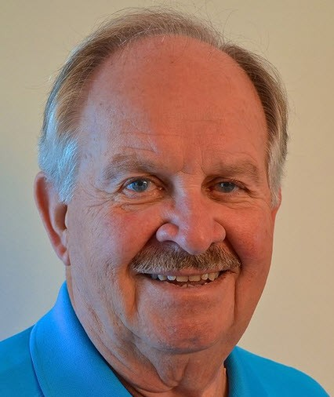
2007-2008
Jerry Loose
Snellville, Georgia

Slide 24
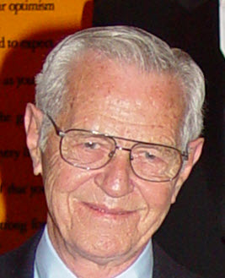
2008-2009
George M. Daniel
Carrollton, Georgia

Slide 25
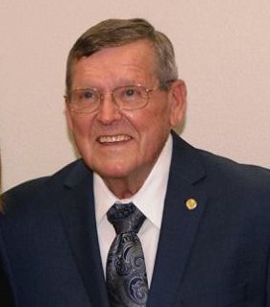
2008-2009
Bob Buss
Kodak, Tennessee

Slide 26
2009-2010
J. Bryan Willingham
Jackson, Mississippi

Slide 27
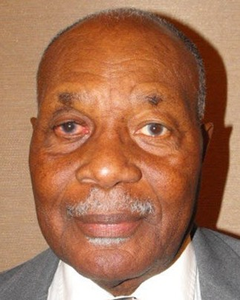
2010-2011
Alfred C. Carson
Sandersville, Georgia

Slide 28
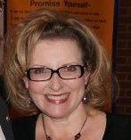
2010-2011
Deanna Morrow
Douglasville, Georgia

Slide 29
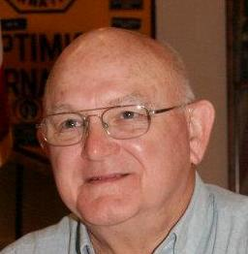
2011-2012
Richard A. Folk
Carrollton, Georgia

Slide 30
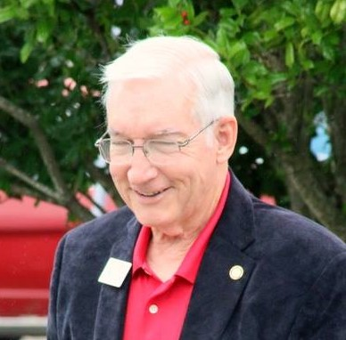
2012-2013
Buzz Buswell
Knoxville, Tennessee

Slide 31
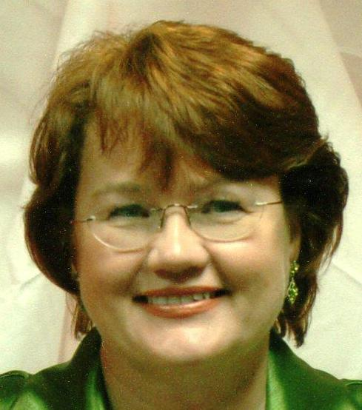
2012-2013
Rose Kohler
Summerville, Georgia

Slide 32
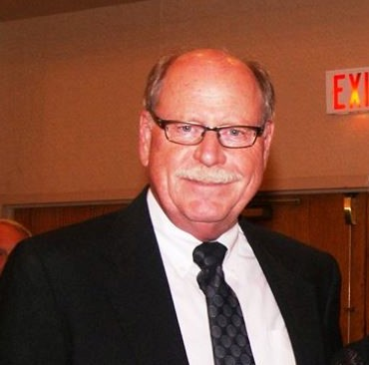
2012-2013
David Harter
Knoxville, Tennessee

Slide 33
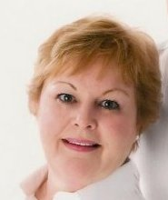
2013-2014
Cheryl Pruitt
Cumming, Georgia

Slide 34
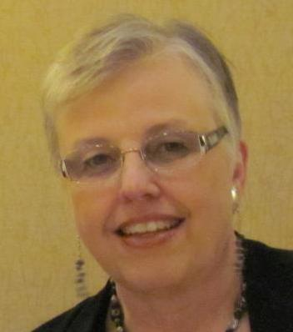
2013-2014
Susan White
Jasper, Georgia

Slide 35
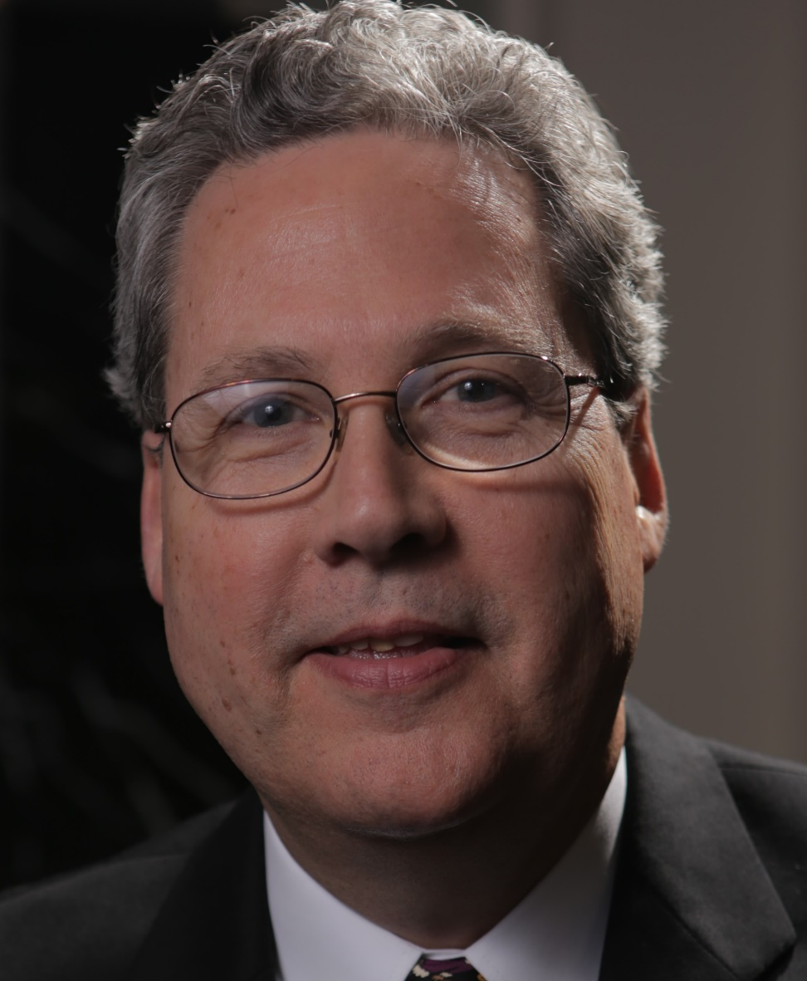
2014-2015
Hal Sewell
Senoia, Georgia

Slide 36
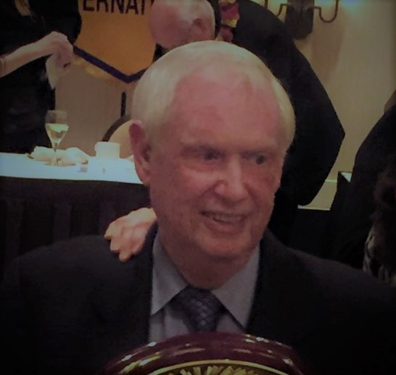
2015-2016
Ed May
Atlanta, Georgia

Slide 37
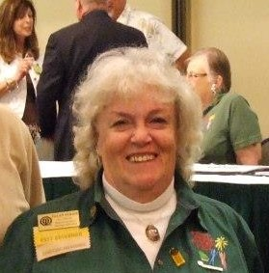
2016-2017
Ellen Strait
Warner Robins, Georgia

Slide 38
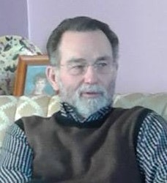
2016-2017
Richard Newman
Athens, Tennessee

Slide 39
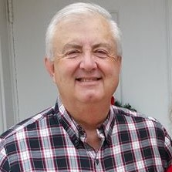
2016-2017
Gerald Johnson
Carrollton, Georgia

Slide 40
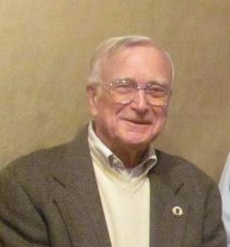
2017-2018
Harry Hackett
Smyrna, Georgia

Slide 41
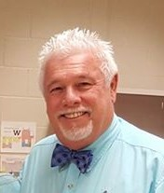
2018-2019
Russell Thomas
Cumming, Georgia

Slide 42
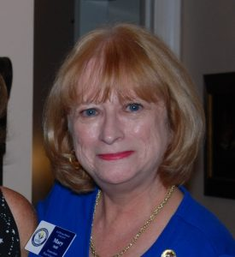
2019-2020
Mary Still
Tucker, Georgia

Slide 43
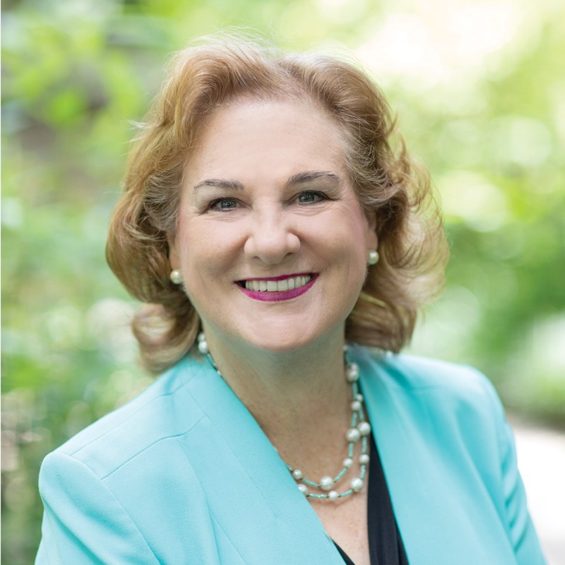
2020-2021
Gwen Gable
Decatur, Georgia

Slide 44
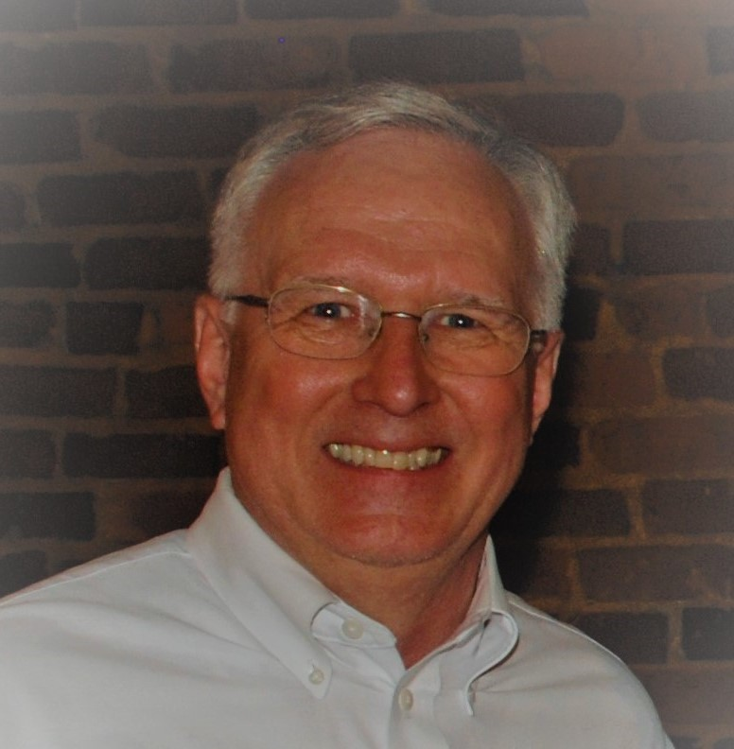
2021-2022
Albert Still
Tucker, Georgia

Slide 45
