Slide 1

Club President-Elect
Working with your Secretary

Slide 2
Very Important Person or Persons
Your Secretary and/or Treasurer are two of the most important people you will be working with.
If you all work together closely your year will be much easier and so much more organized.

Slide 3
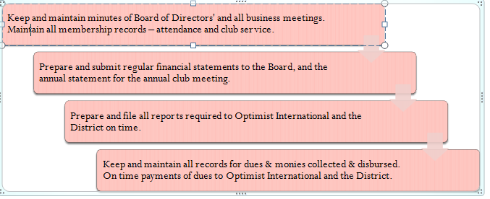
Duties of the Secretary/Treasurer
Notes:
As you can see the jobs of your secretary and/or treasurer are not light. A big part of your success depends on them being able to do their jobs successfully. Open lines of communication are a must to have information available where and when needed. A good Secretary/Treasurer will make your job as President much, much, easier and less stressful. By making sure that dues are collected from membership and then paid to Optimist International and the District on time, along with reports, minutes and financial documents you will have a lot less to worry about.

Slide 4
Other Duties

Slide 5
Secretaries also…
Keep up with Correspondence
Send Get Well Cards
Help with Agendas
And the list goes on……
Notes:
Secretaries do so many other jobs, especially if you have a small club and there are not other people to take on these responsibilities. Such as, birthday and get well cards, agendas, and stories for the media.

Slide 6
Treasurers also…
Dues –
A Three Letter Plan for Dues Collection

Slide 7
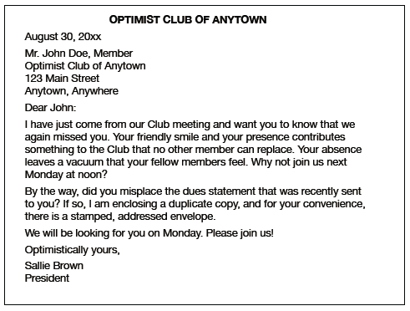
Sample Letter 1

Slide 8
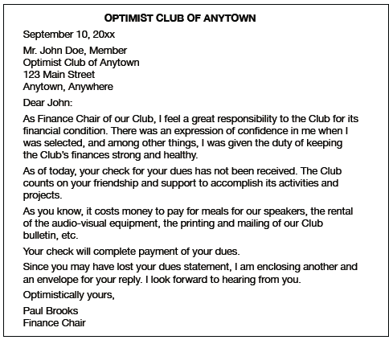
Sample Letter 2

Slide 9
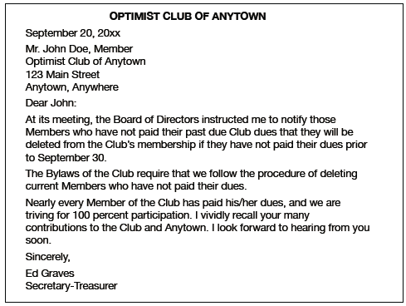
Sample Letter 3

Slide 10
Reports
Club Roster Adjustments
Club Pride Report
Club Officer-Elect Report
JOI Club Reports and Awards
Honor Club Tracking Form
Notes:
Club Roster Adjustments - Signature of President and Signature of Secretary-Treasurer Required.
Club Pride Report – Due September 30th - Signature of Club Officer required.
Club Officer-Elect Report - Due May 20th
JOI Club Reports and Awards: Clubs that sponsor Alpha, Junior Optimist and/or Octagon Clubs must file Officer-Elect Reports by May 30th. Club rosters are due by October 1st. Both reports are filed with the International Officer. Clubs awards are listed in the annual Youth Clubs Planning Guide. Deadlines vary from May 30th to September 30th

Slide 11
Give Praise When Praise is Due
Always make sure you give your Secretary/Treasurer the praise deserved. A “Thank you” and a pat on the back go a long way.
Remember them at awards time!!
Notes:
Always remember to say “Thank You” and often. Give Praise for a job well done in front of the club membership. At awards time make sure the membership knows that it is the secretary/treasurer that keeps up with the information necessary for the club and the membership to receive their awards.

Slide 12
What is the recognition given to the key builder of a new Optimist Club?
Notes:
ANSWER: Builder of Excellence

Slide 13
What is the name of the form that a Club can use to find out what a member is interested inn doing?
Notes:
ANSWER: Member Interest Finder

Slide 14
When is the Club Officer Elect Report due?

Slide 15
What two items should all Club reports include?
Notes:
ANSWER: Official Club name and number

Slide 16
Name something a new member receives when joining an Optimist Club.
Notes:
ANSWER: lapel pin, Optimist Creed, certificate of membership, name badge, lots of friends, opportunity to serve, etc.

Slide 17
What Optimist publication does every Club President receive?
Notes:
ANSWER: Leadership Hotline (via Club email box)

Slide 18
What is the suggested minimum initiation fee for a new member?
Notes:
ANSWER: $30 U.S.

Slide 19
What is the processing fee sent to Optimist International Headquarters for a new member?
Notes:
ANSWER: $15 U.S.

Slide 20
What Club officer is a member of the District Board of Directors?
Notes:
ANSWER: Club President

Slide 21
What does a Past Distinguished President wear with pride?

Slide 22
Where does the name of an Honor Club President appear forever in a Club’s history?
Notes:
ANSWER: On the Club Banner

Slide 23
What does P G I stand for?
Notes:
ANSWER: Personal Growth and Involvement

Slide 24
How many levels of achievement are available for a Club member in the PGI Program?
Notes:
ANSWER: Ten

Slide 25
What does PDP stand for?
Notes:
ANSWER: Professional Development Program

Slide 26
What is considered the pay of a volunteer?
Notes:
ANSWER: Recognition

Slide 27
How do you get a new member
to join your Club?
Notes:
ANSWER: Ask

Slide 28
Questions???

