Slide 1
EMAIL
How to set up account, send emails and email etiquette
Mary Still
Kathy Forster

Slide 2
We are not affiliated with or endorse the email service providers listed here. We are providing you with information about various options to help you get an email account set up. The email service provider you select is your choice.

Slide 3
gmail
How to set up a gmail account

Slide 4
Setting up a Gmail Account (Google Email)
Go to http://mail.google.com to open your new Gmail account. Click the "Create an Account" link.
On the Create an Account page, start by filling in the following information:
First name
Last name
Desired login name (be sure to click on the check availability box to ensure you get the login name you want)
Select an 8 character minimum password.
Enter a security question from the drop down menu. Try to choose one that would not be easy for someone else to answer.
Type in the answer to your security question.
Select your Country location from the drop-down menu.
Type in the characters that you see for the word verification.
Review the Google Terms of Service. If you accept the terms, click on the "I accept. Create my account" button.

Slide 5
yahoo
How to set up a yahoo account

Slide 6
Setting up a Yahoo! Email Account
Go to the Yahoo Mail home page.
Click on the "Sign Up" link that appears near the top of the page.
Enter your name and other requested information in the fields provided.
Create a username that you will be comfortable using for a long time and will identify you to your email recipients. Remember that you can use numbers and letters.
Type the username you choose in the field provided. Check the availability of your username by clicking the box below that reads 'Check Availability of This ID.' You may have to think of an alternative username if your top choice is already taken by another Yahoo user.
Choose a password when you have successfully entered a unique username. Passwords must be at least 6 characters long and keep in mind that passwords are case-sensitive. You will be asked to type your password twice to ensure accuracy.

Slide 7
Select a question from the drop-down menu as your security question. Yahoo will ask you this question if you should forget your password in the future, in order to verify that you are the correct user.
Type in your answer to the question in the field below.
Enter your birth date, zip code and any other requested information in the fields provided.
Verify your registration by typing the characters you see shown in the last section of the registration page into the field provided.
Read the Terms of Service.
Select 'I Agree.' You have successfully set up your Yahoo email account.

Slide 8
Optimist leaders
www.Optimistleaders.org

Slide 9
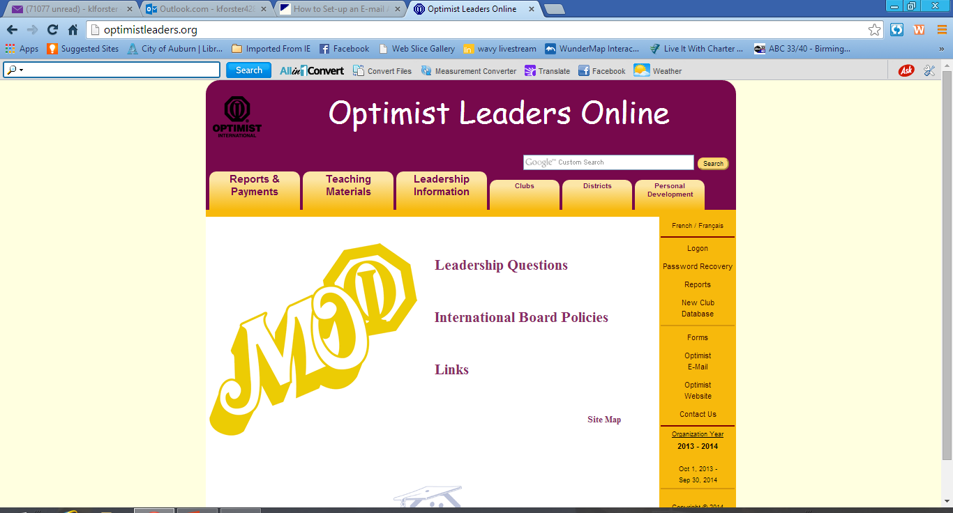

Slide 10
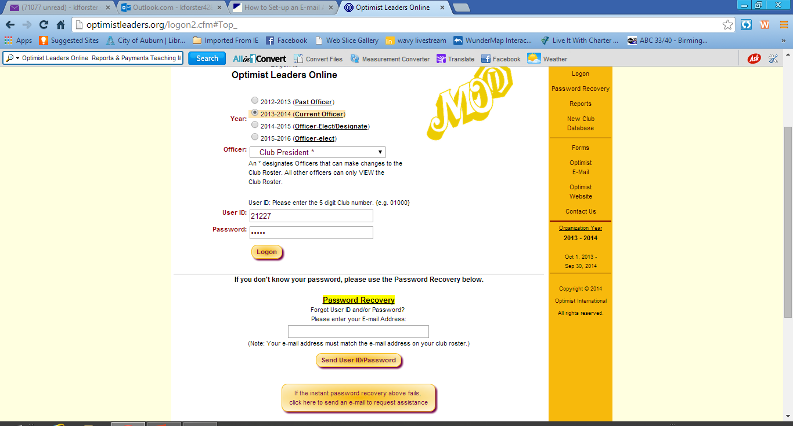

Slide 11
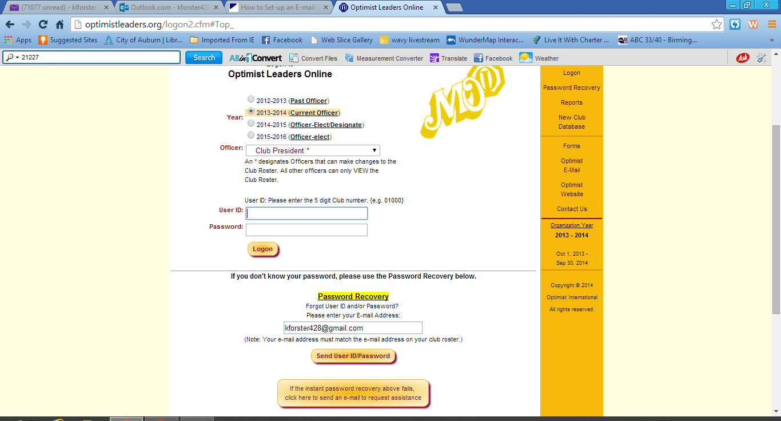

Slide 12
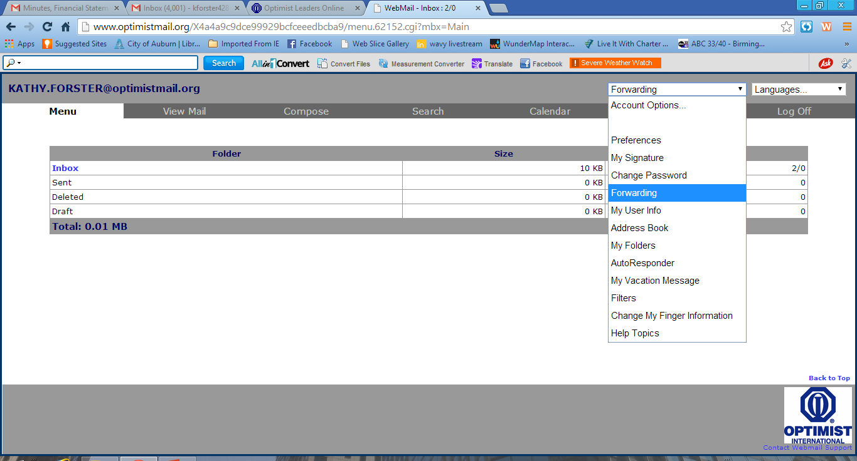

Slide 13
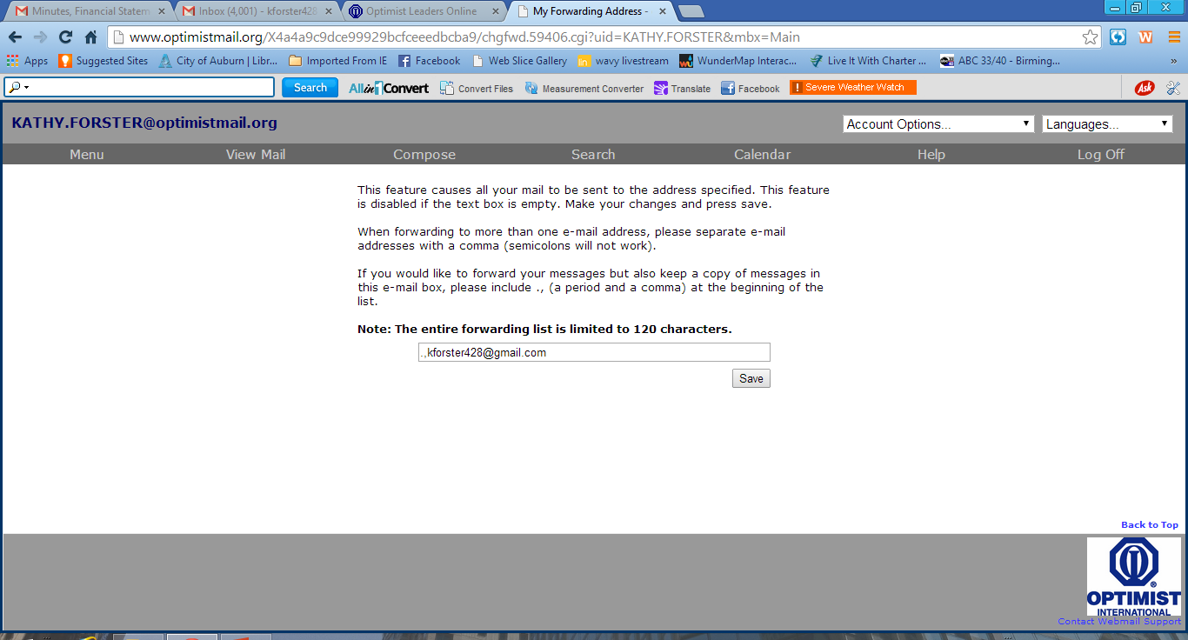

Slide 14
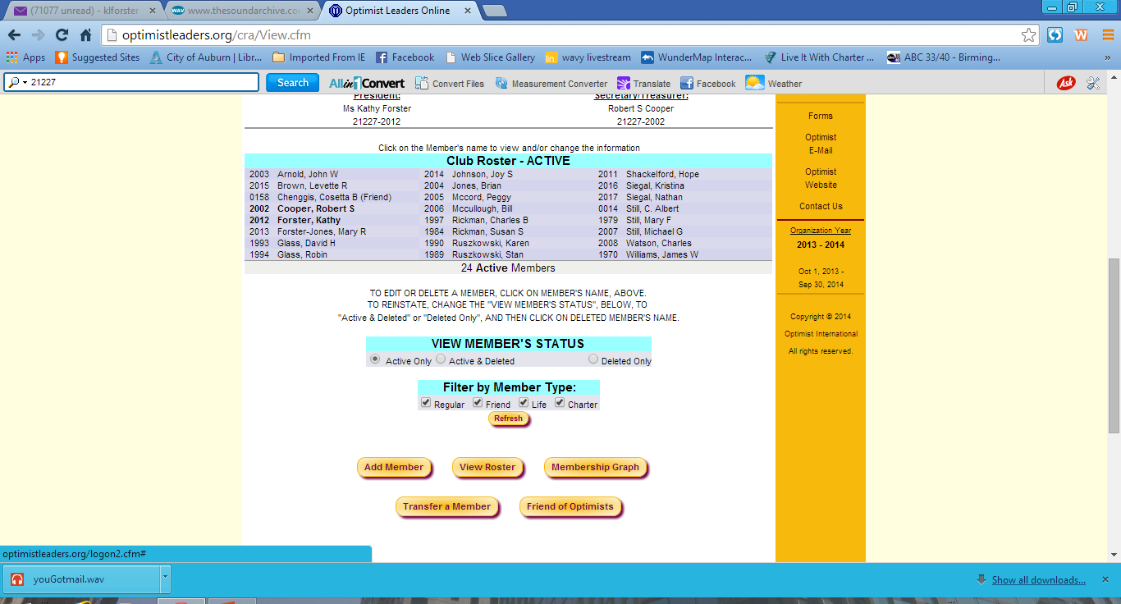

Slide 15
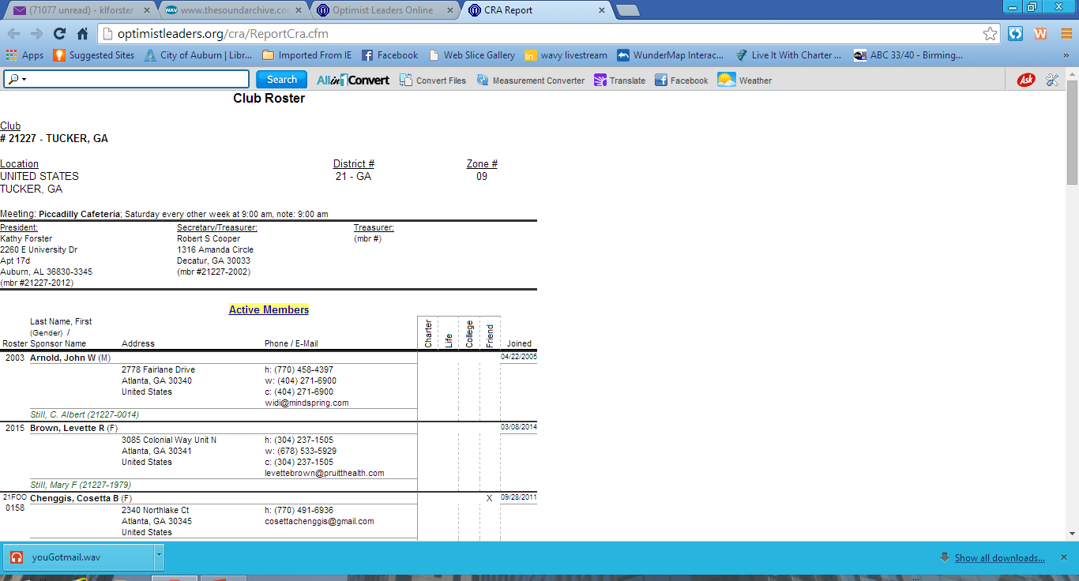

Slide 16
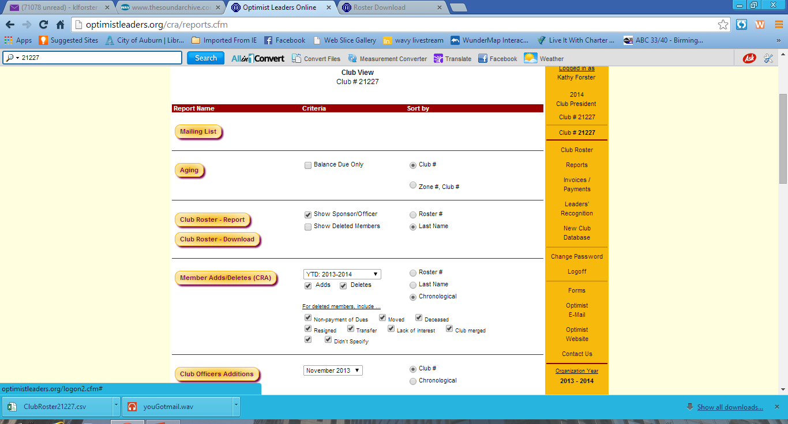

Slide 18
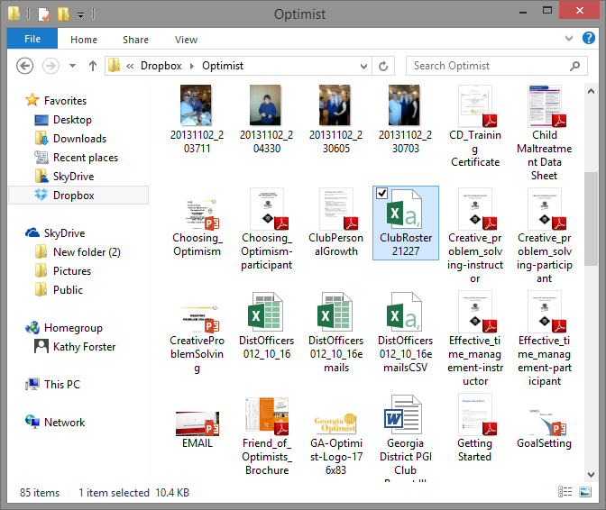

Slide 19
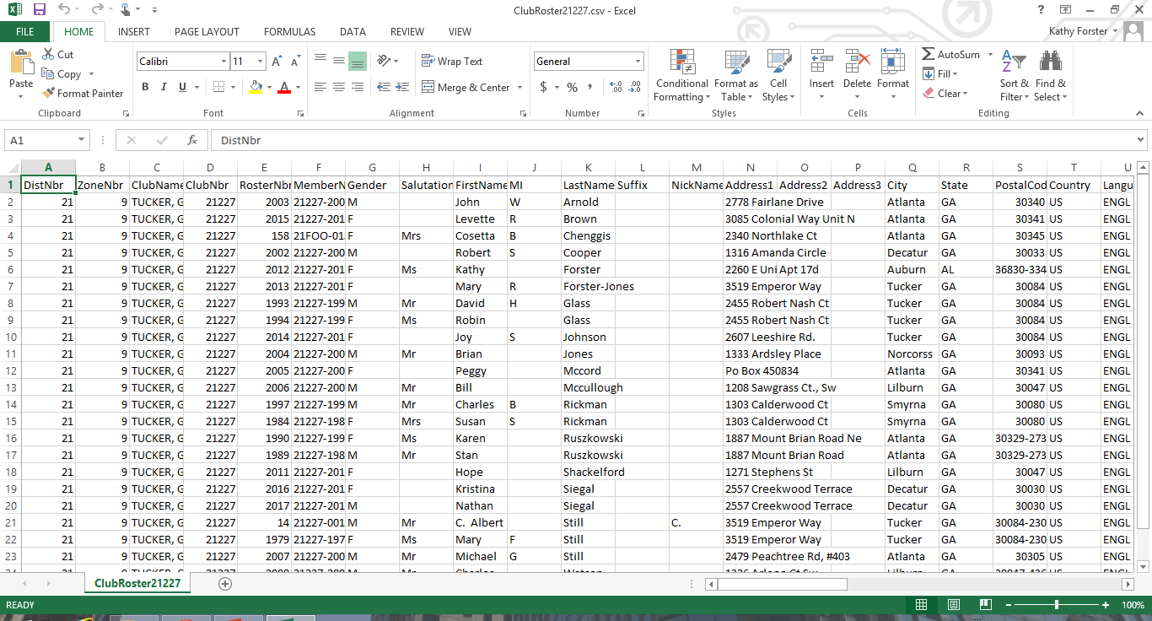

Slide 20
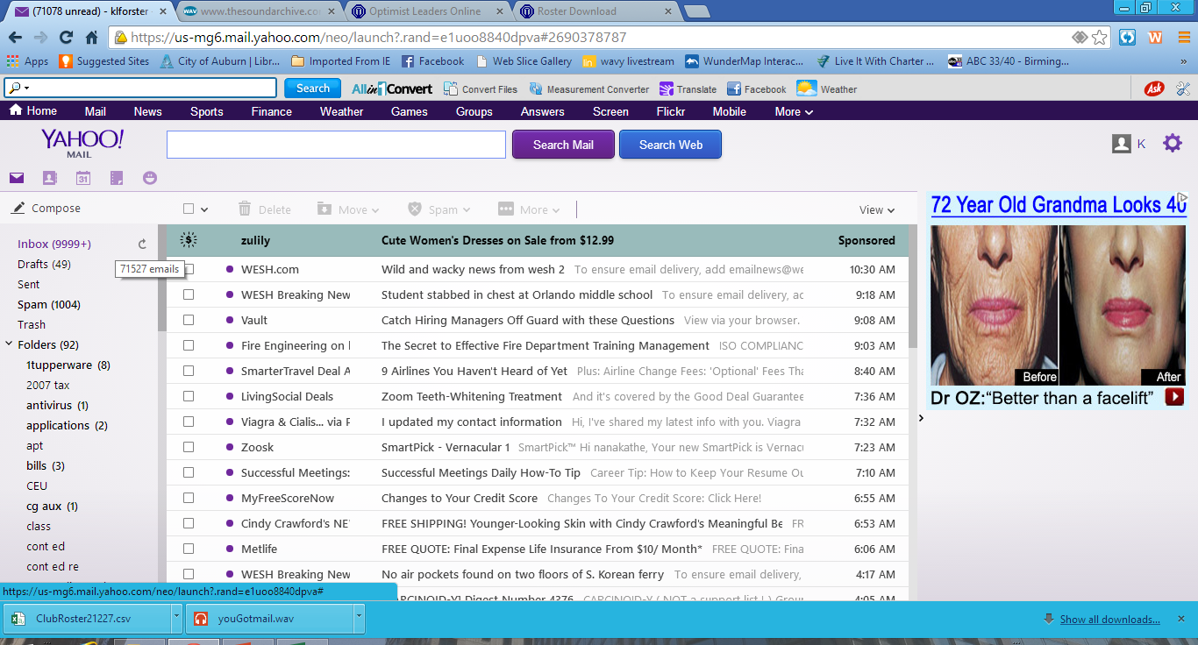

Slide 21
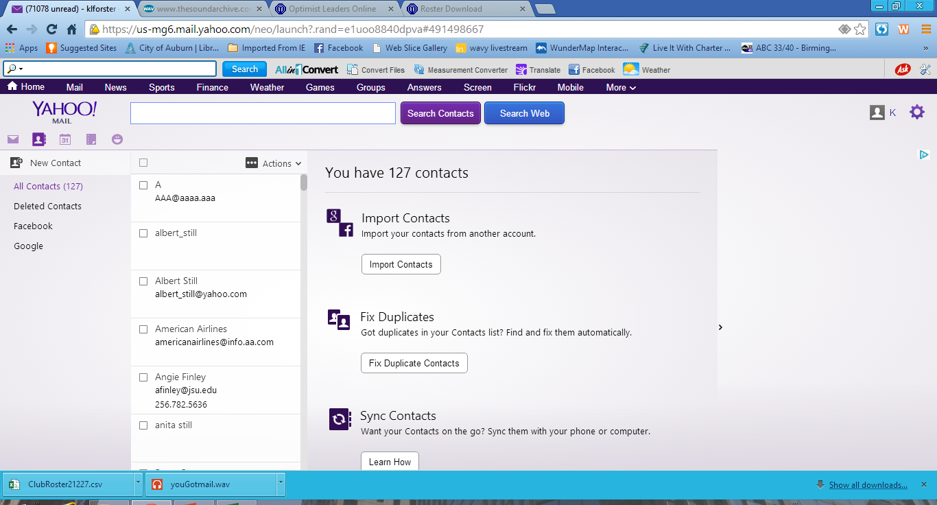

Slide 22
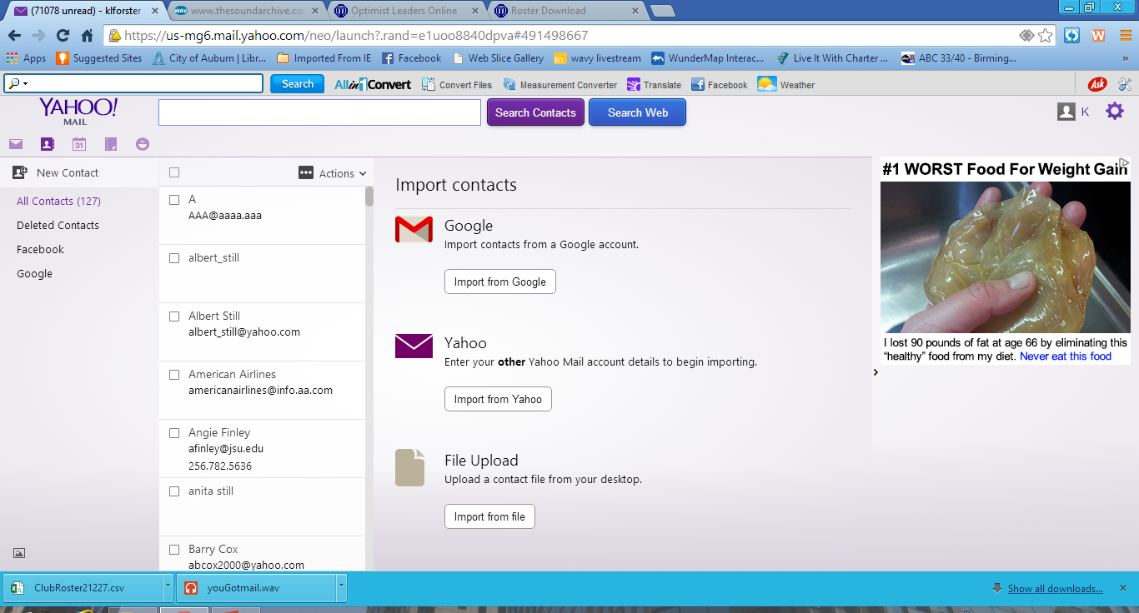

Slide 23
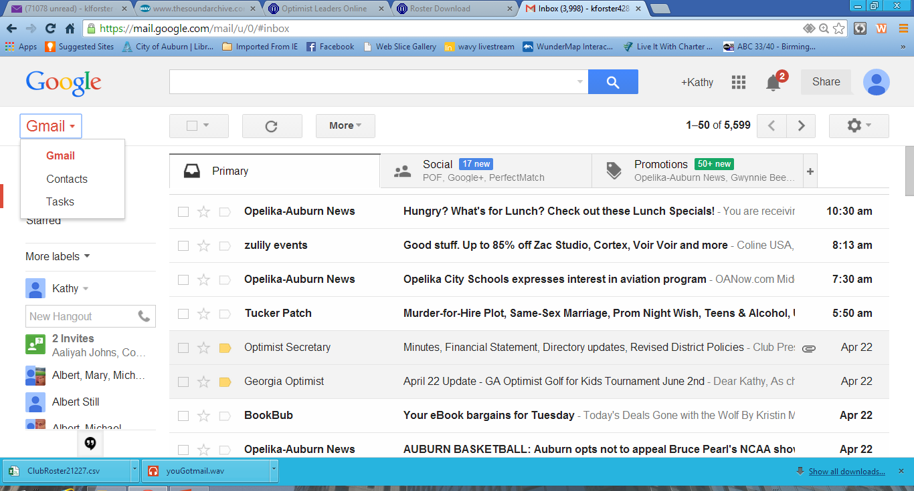

Slide 24
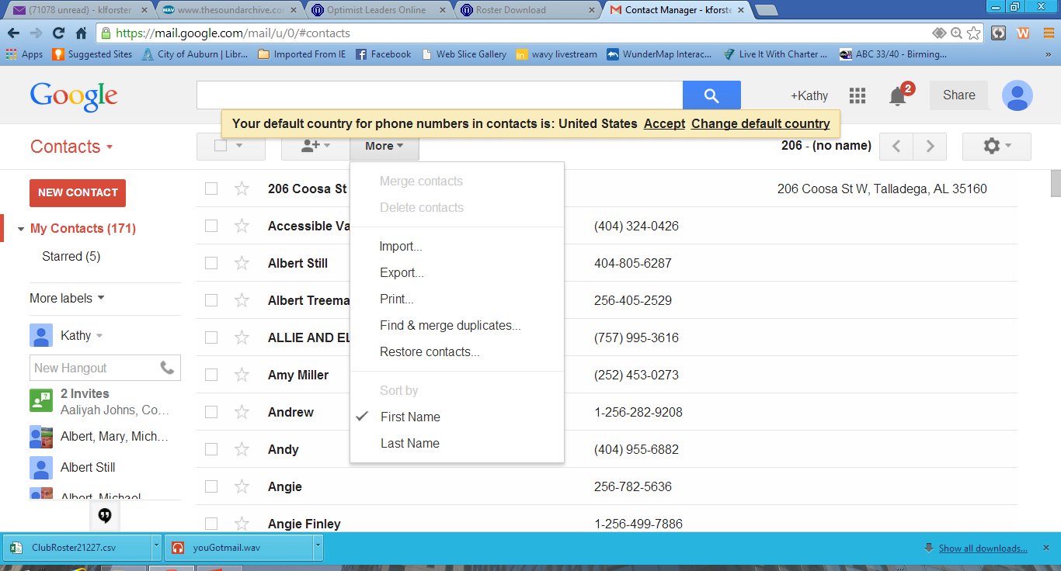

Slide 25
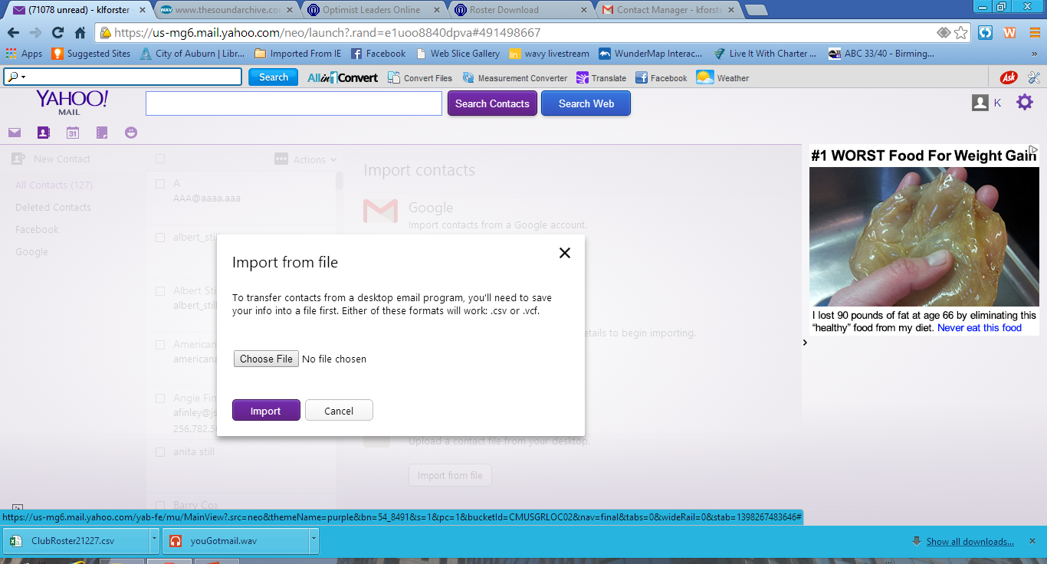

Slide 26
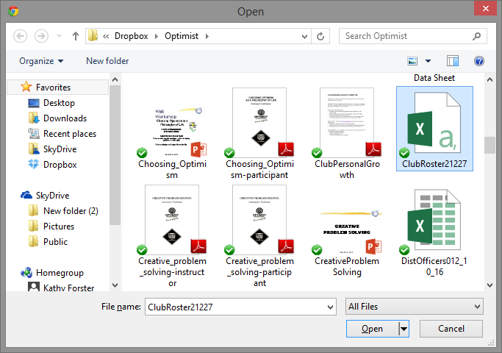

Slide 27
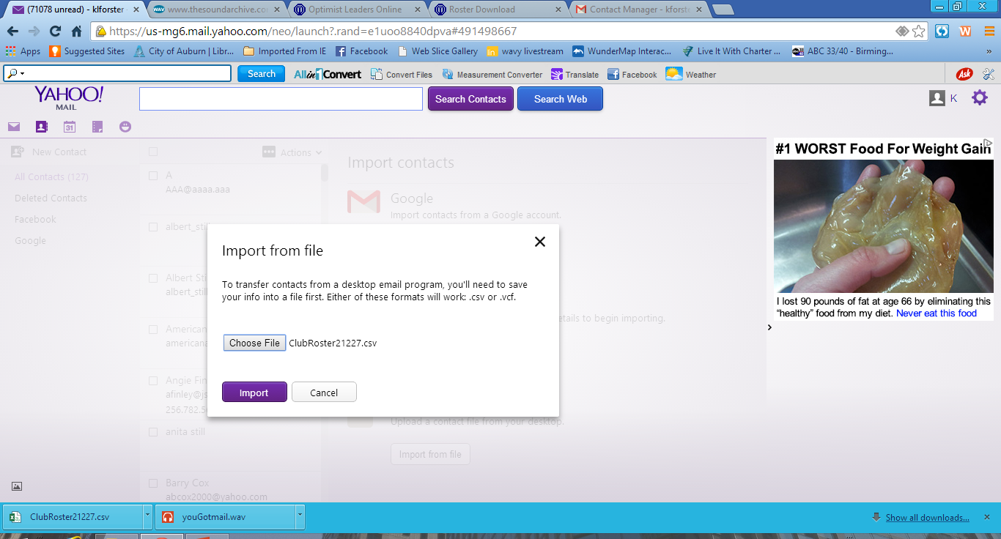

Slide 28
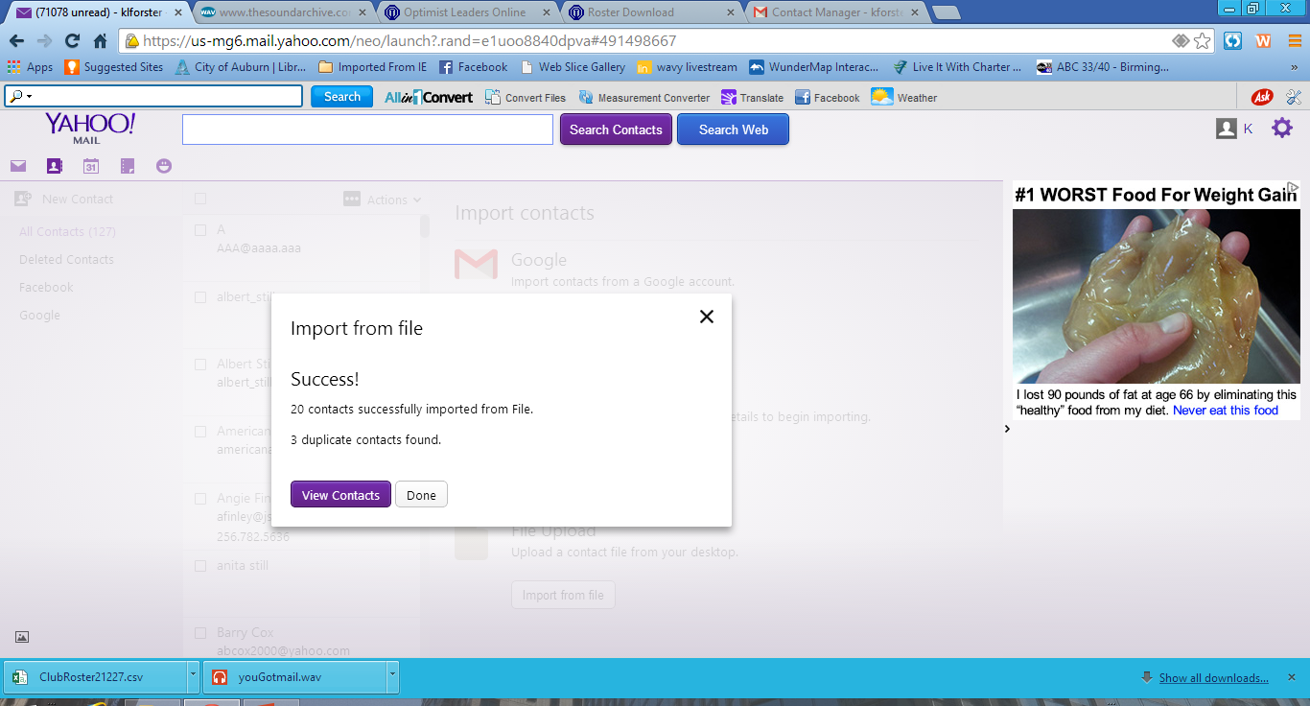

Slide 29
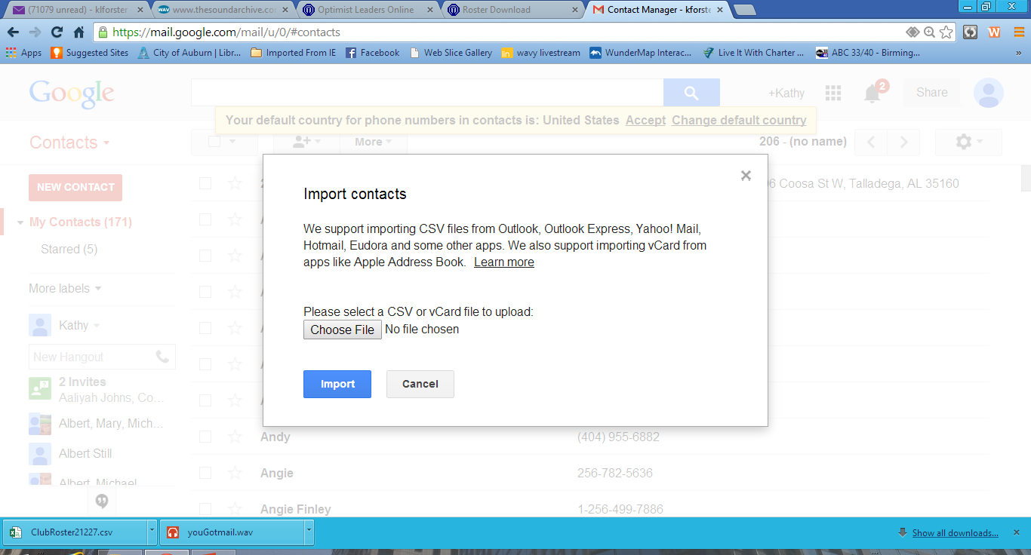

Slide 31
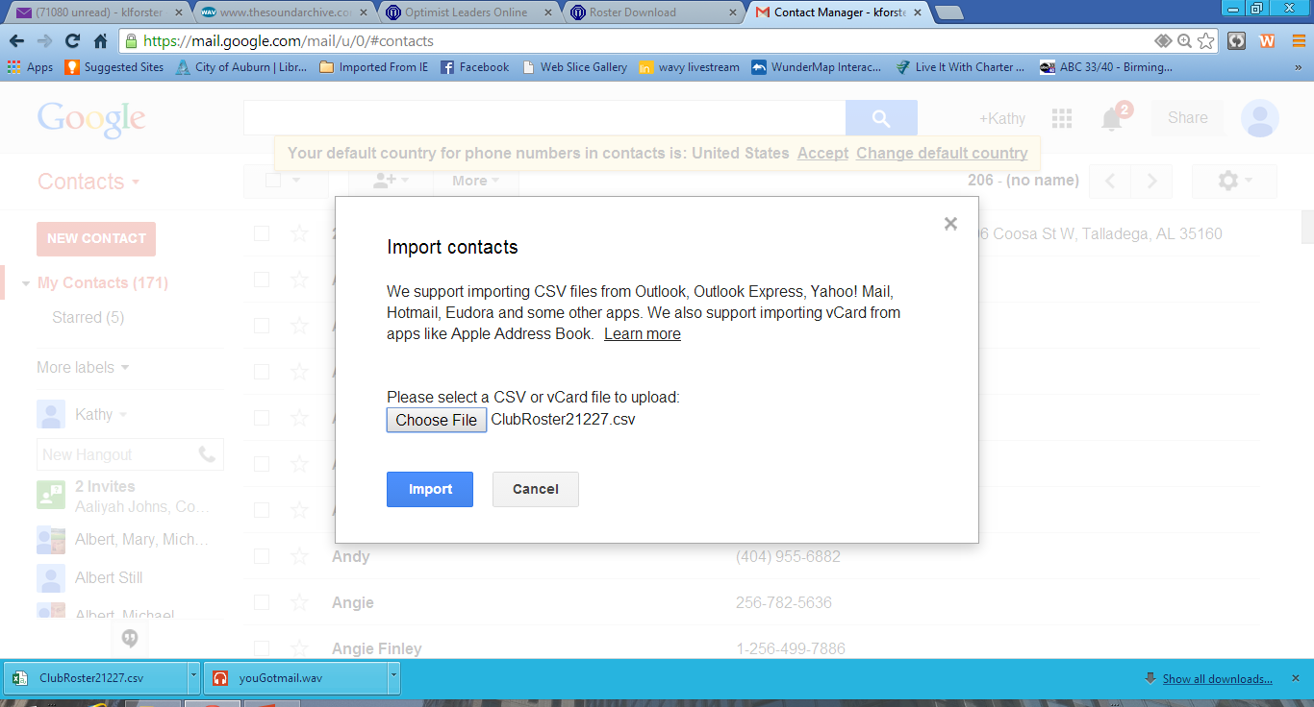

Slide 32
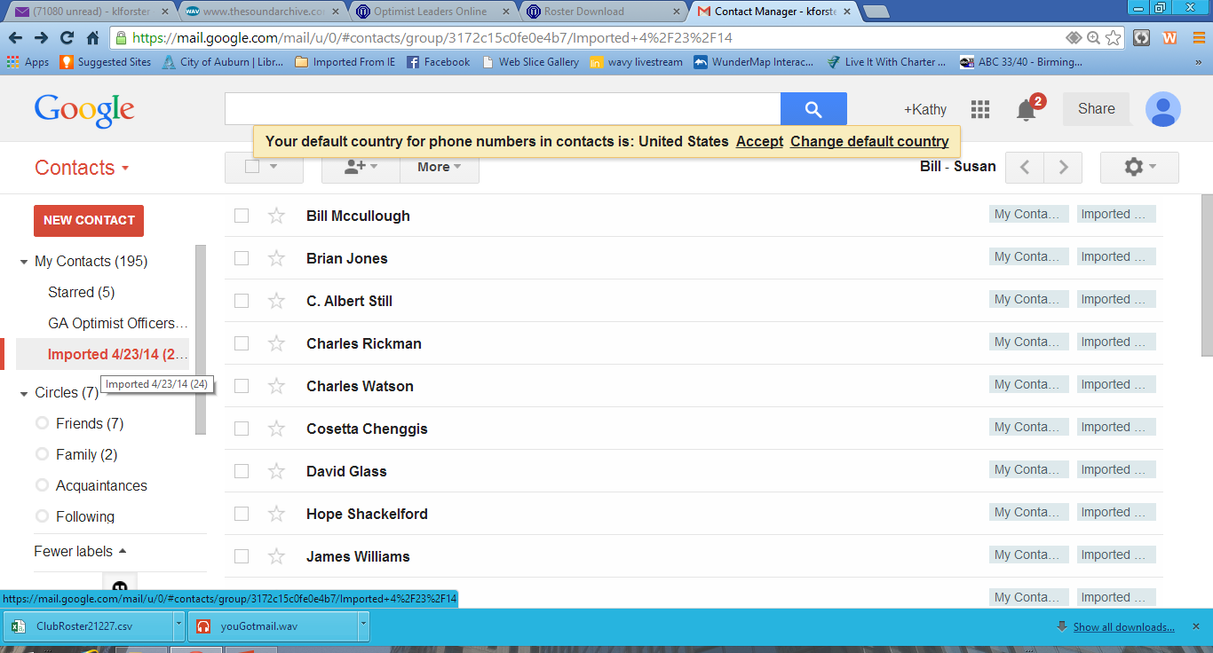

Slide 33
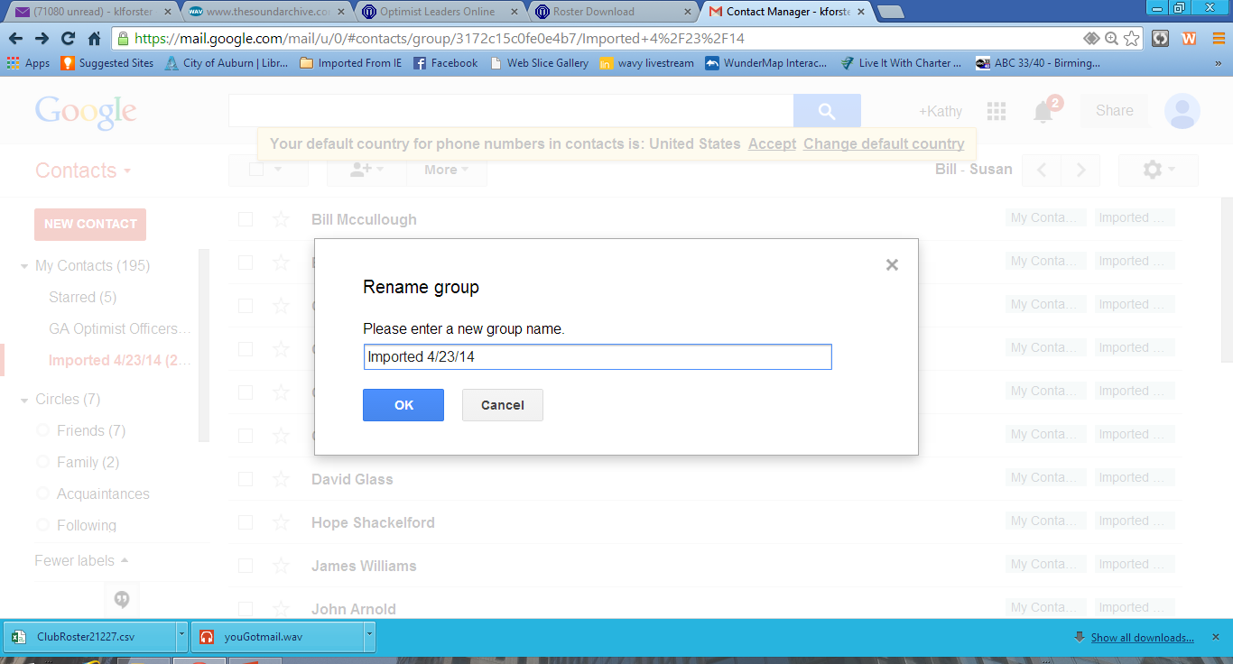

Slide 35
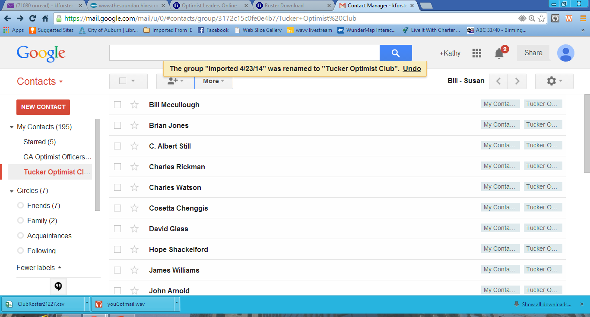

Slide 36
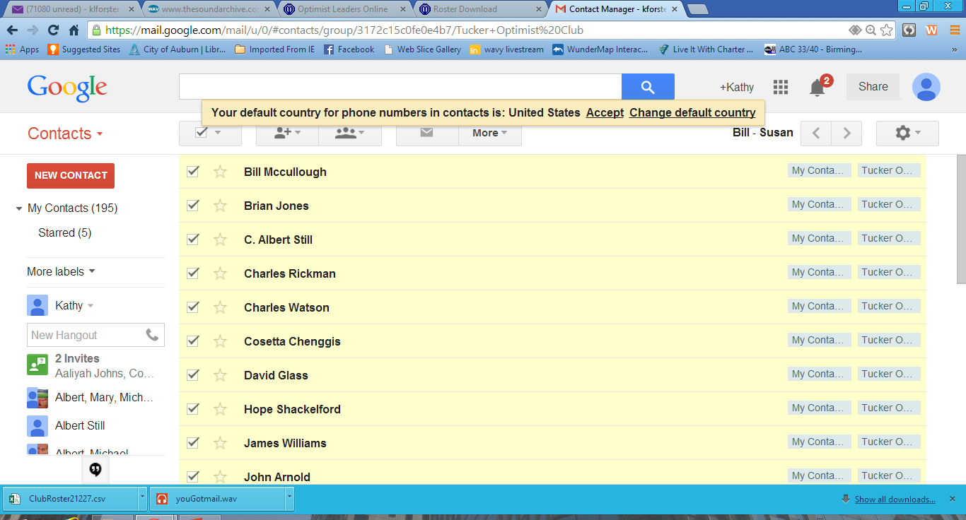

Slide 37
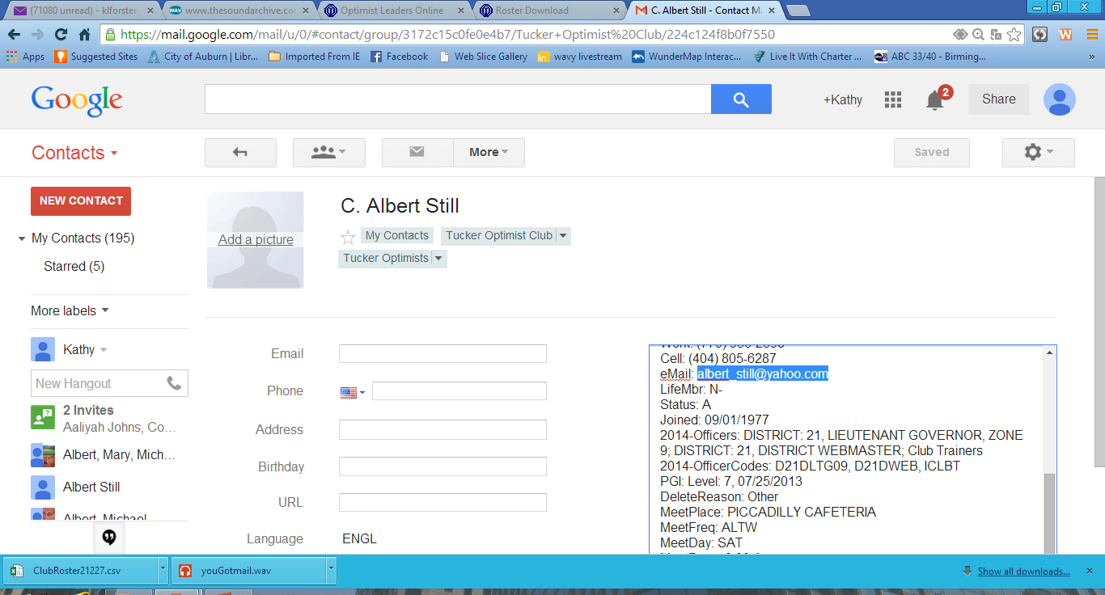

Slide 38
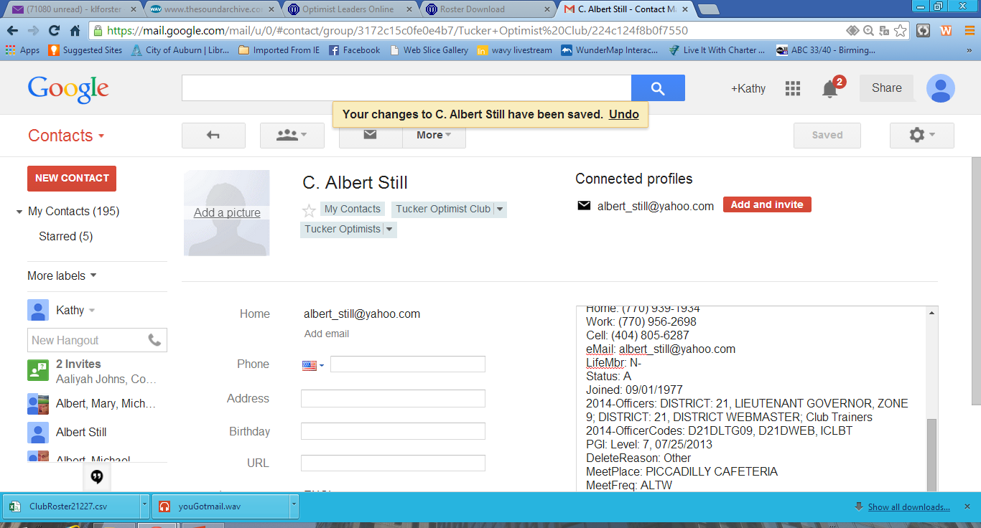

Slide 39
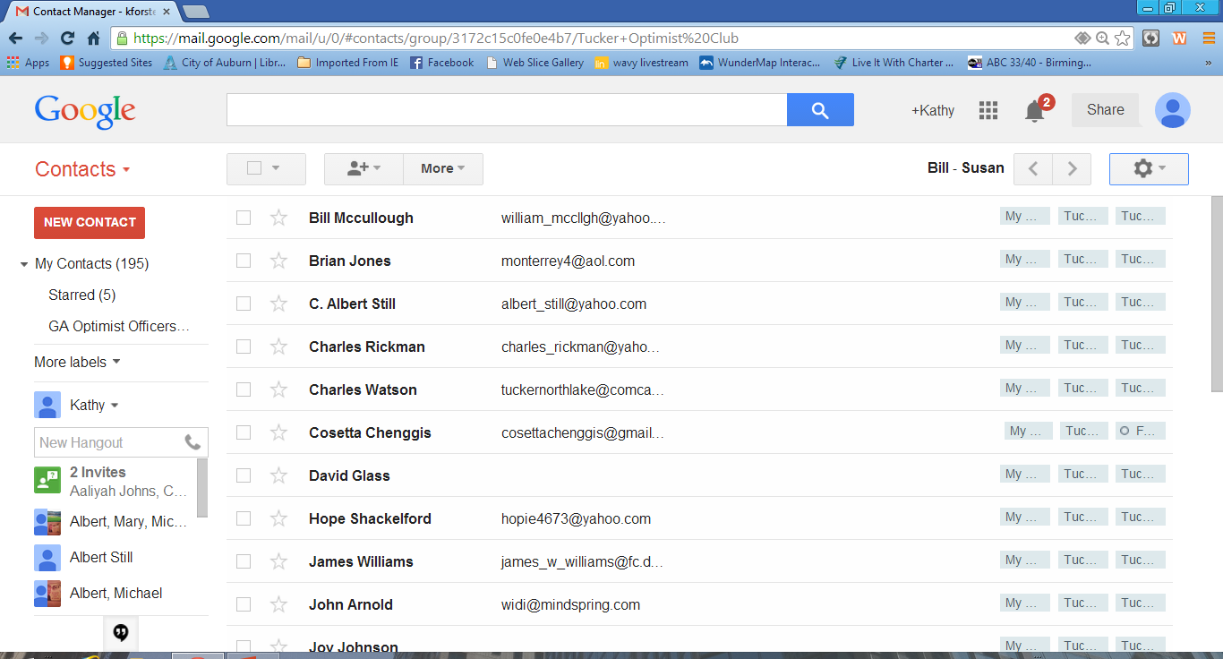

Slide 40
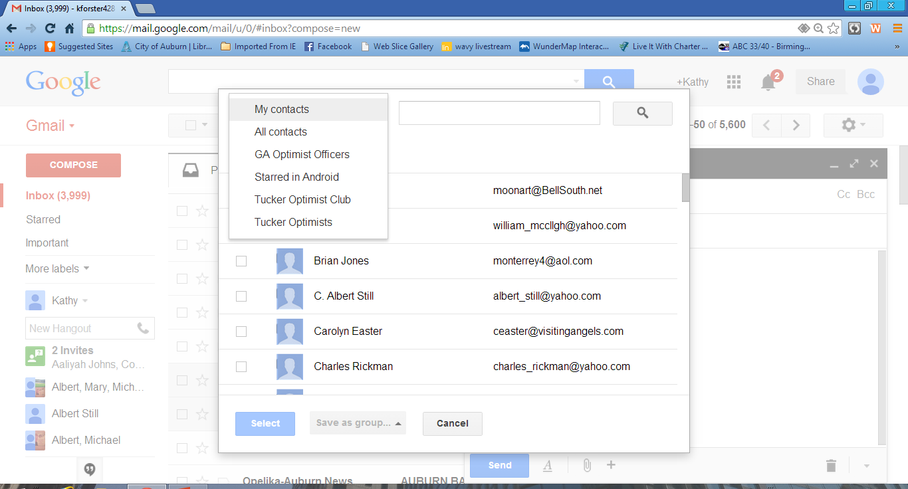

Slide 41
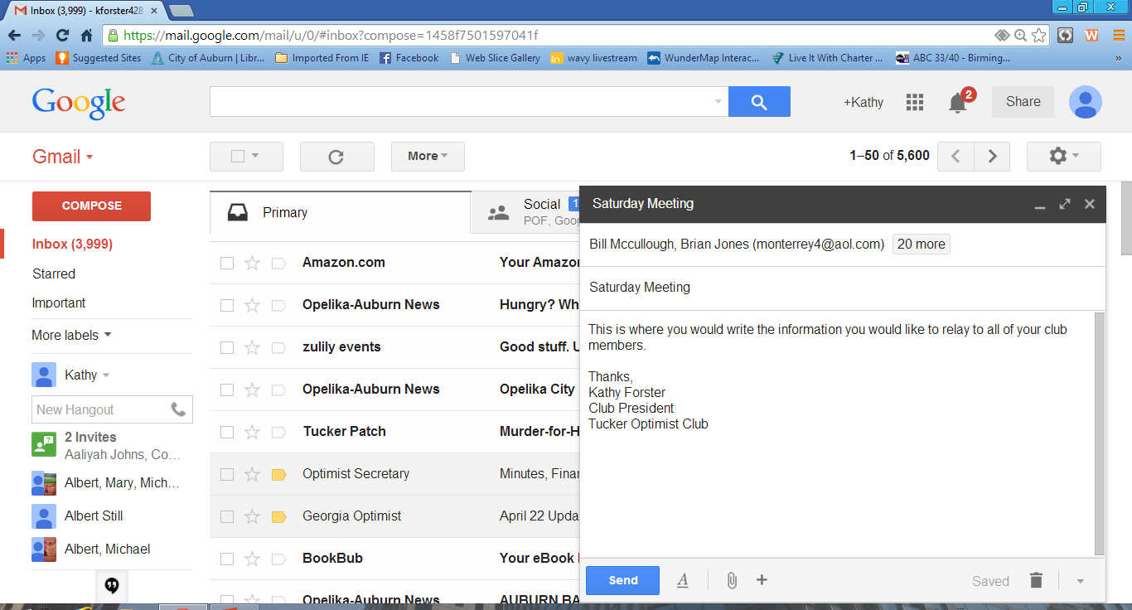

Slide 42
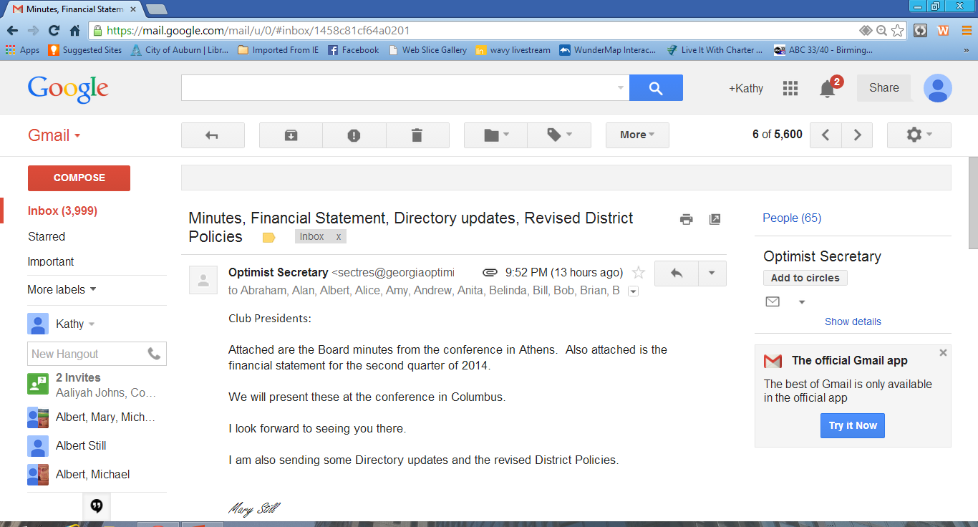

Slide 43
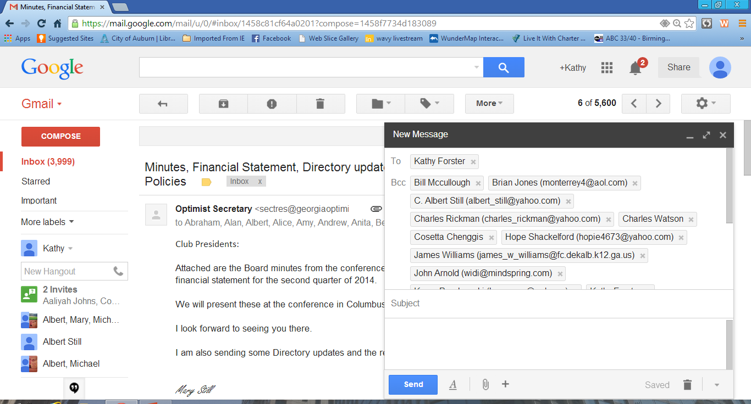

Slide 44
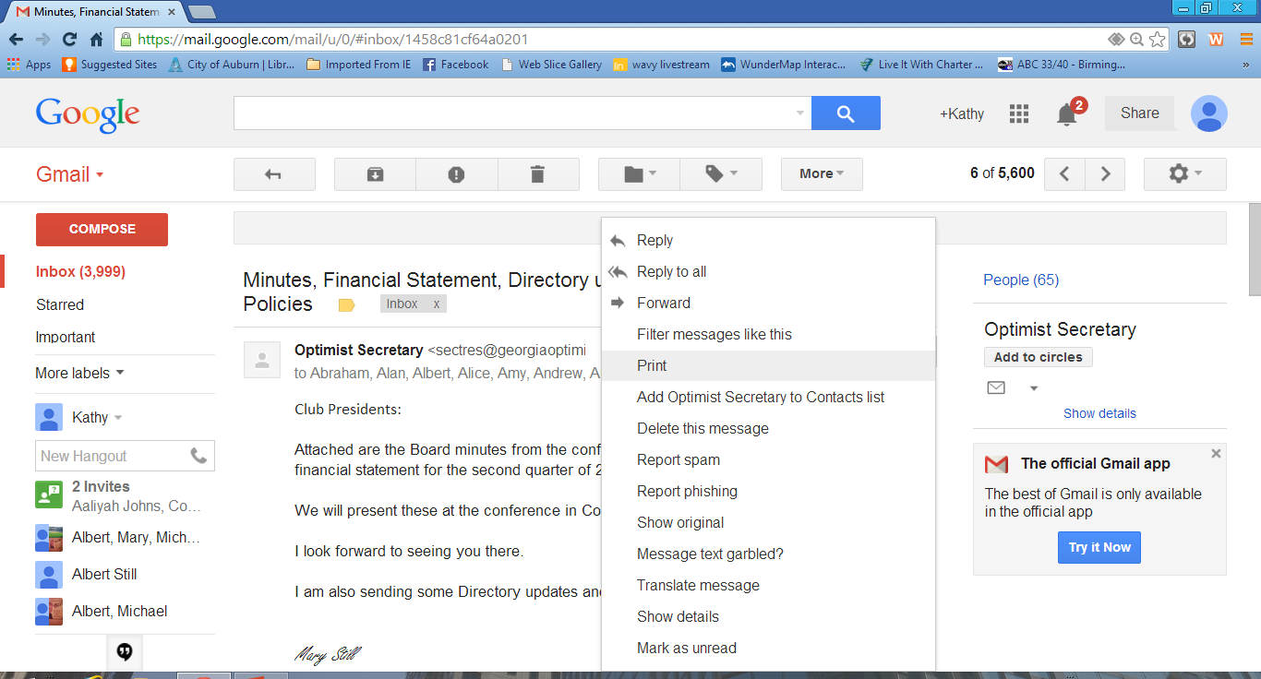

Slide 45
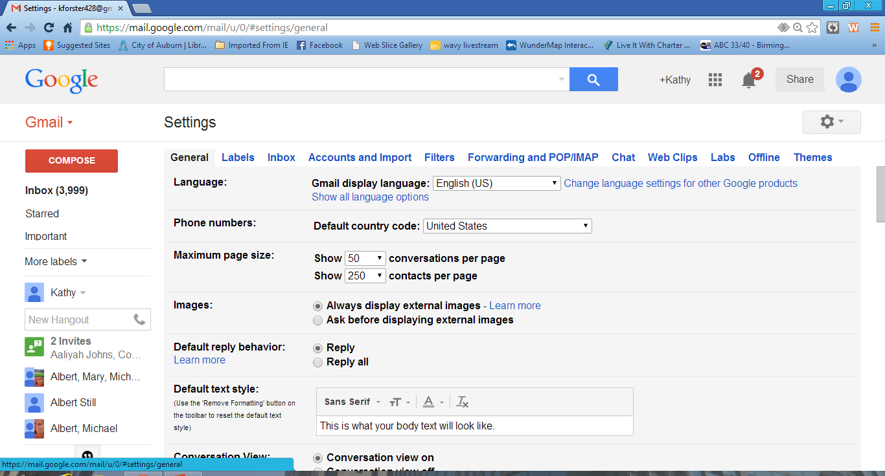

Slide 46
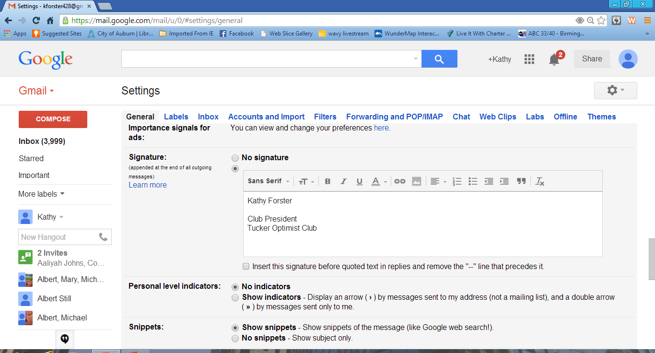

Slide 47
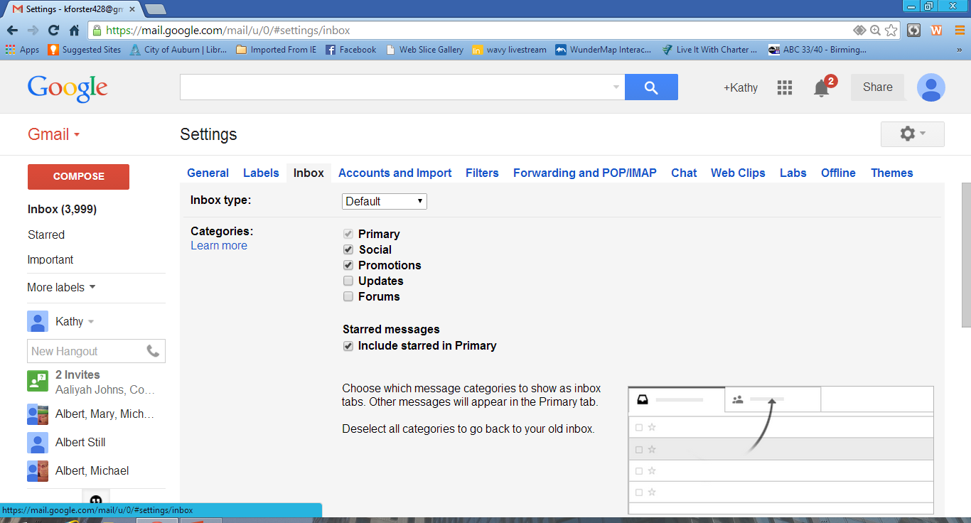

Slide 48
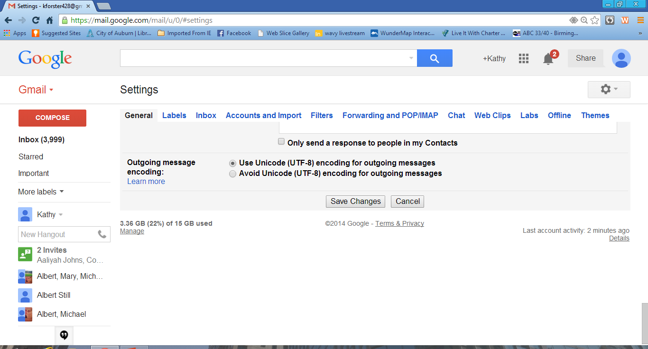

Slide 49
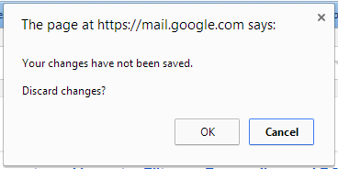

Slide 50
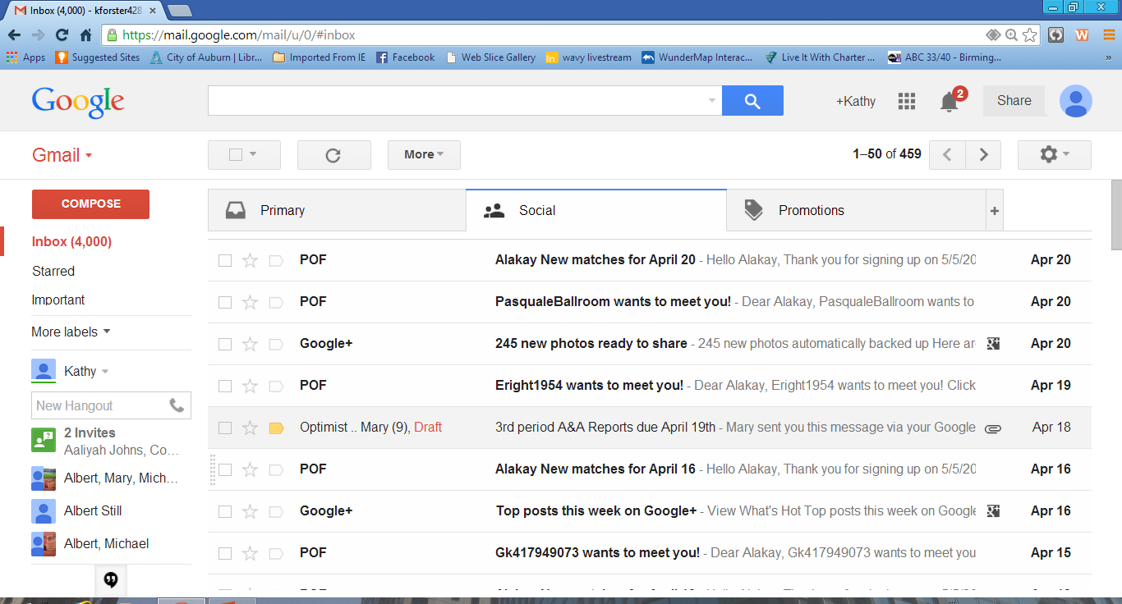

Slide 51
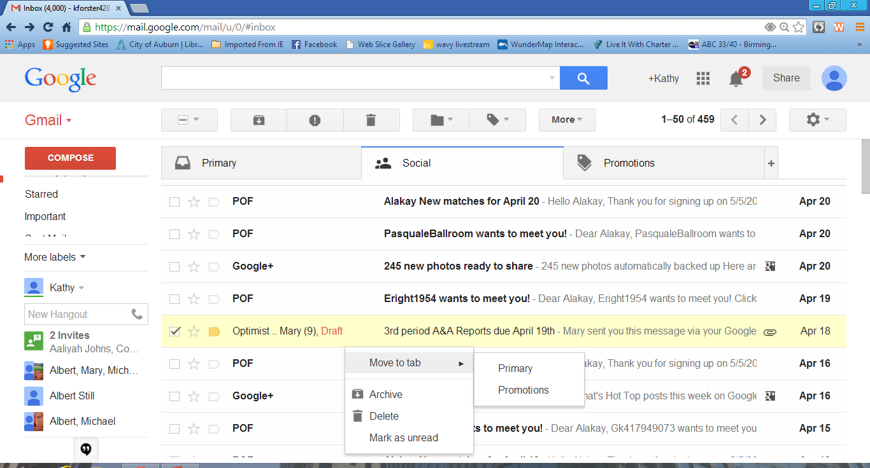

Slide 52
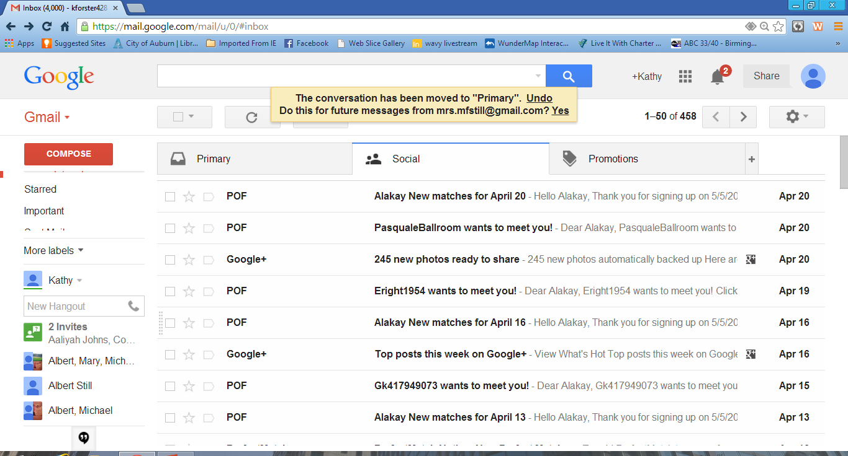

Slide 53
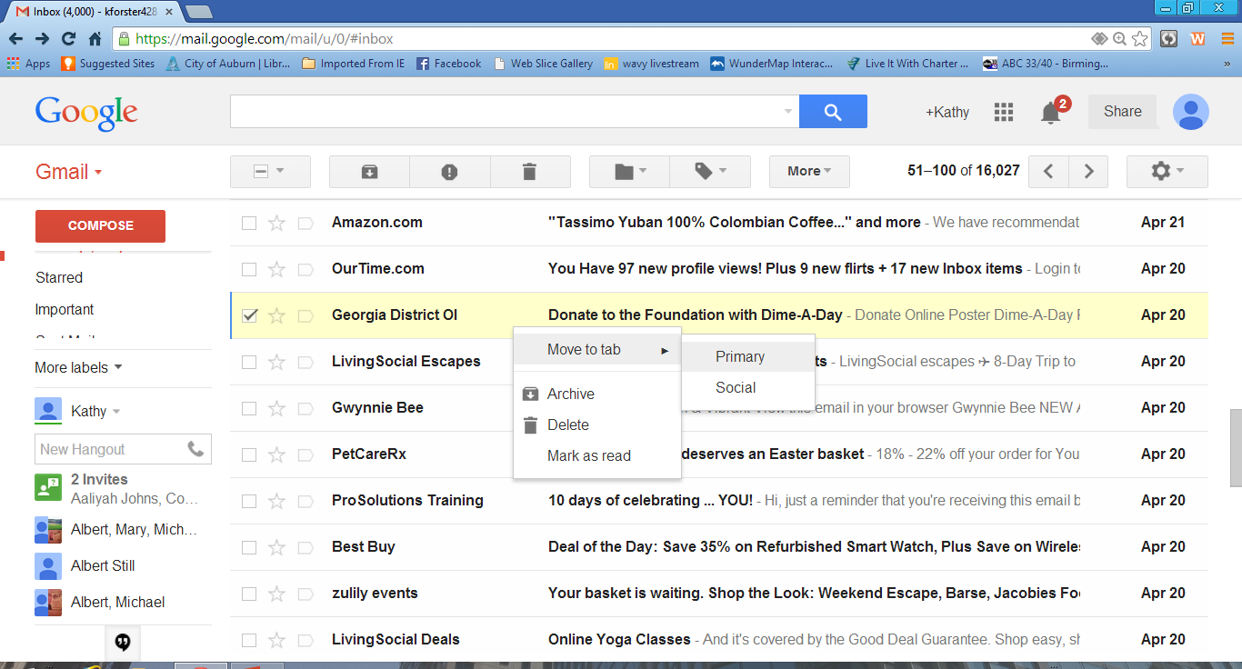

Slide 54
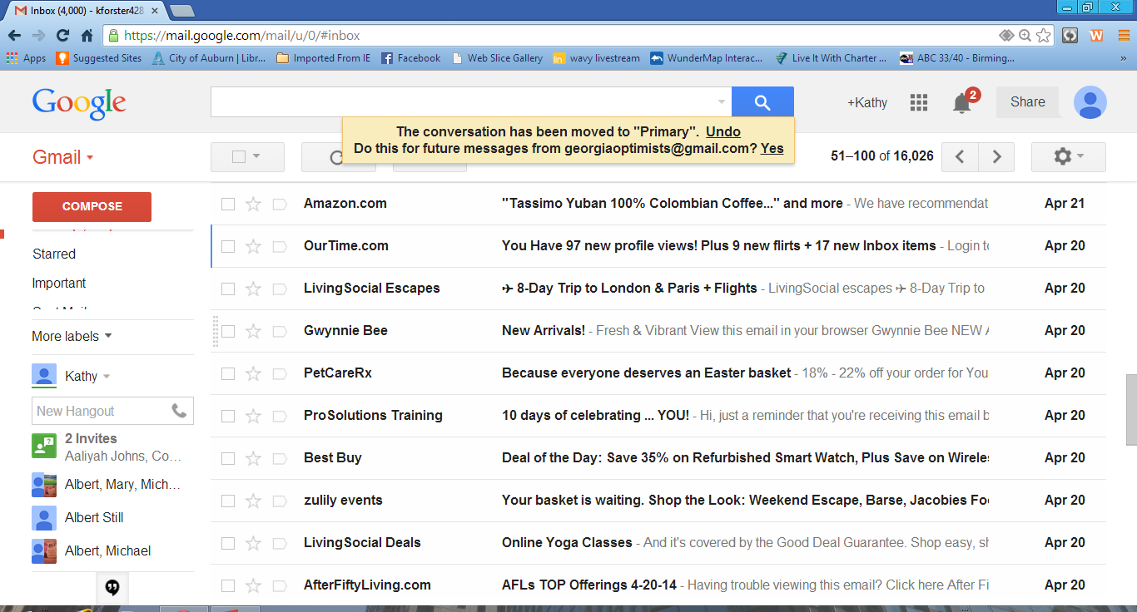

Slide 55
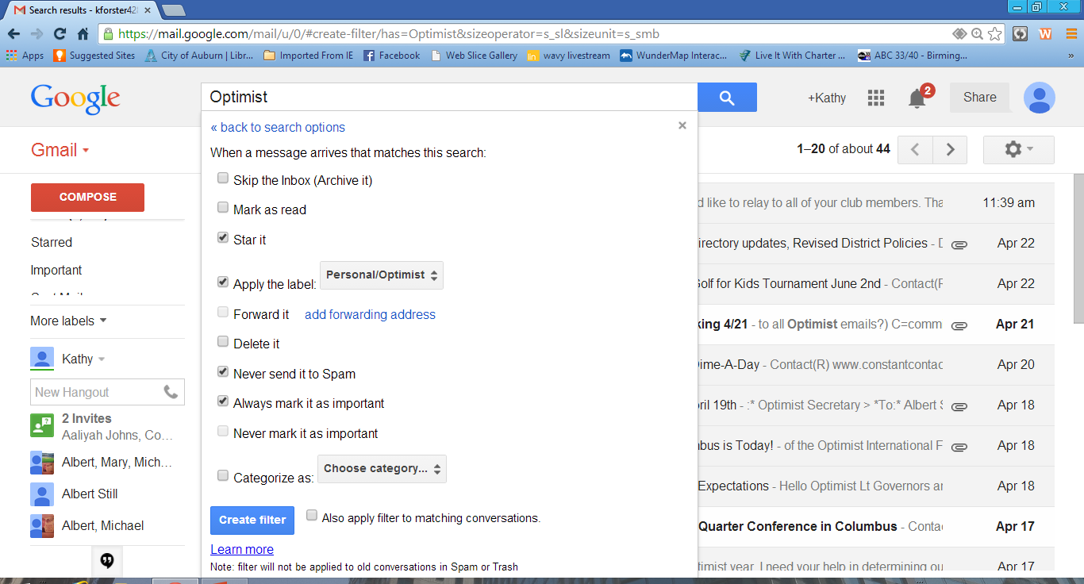

Slide 56
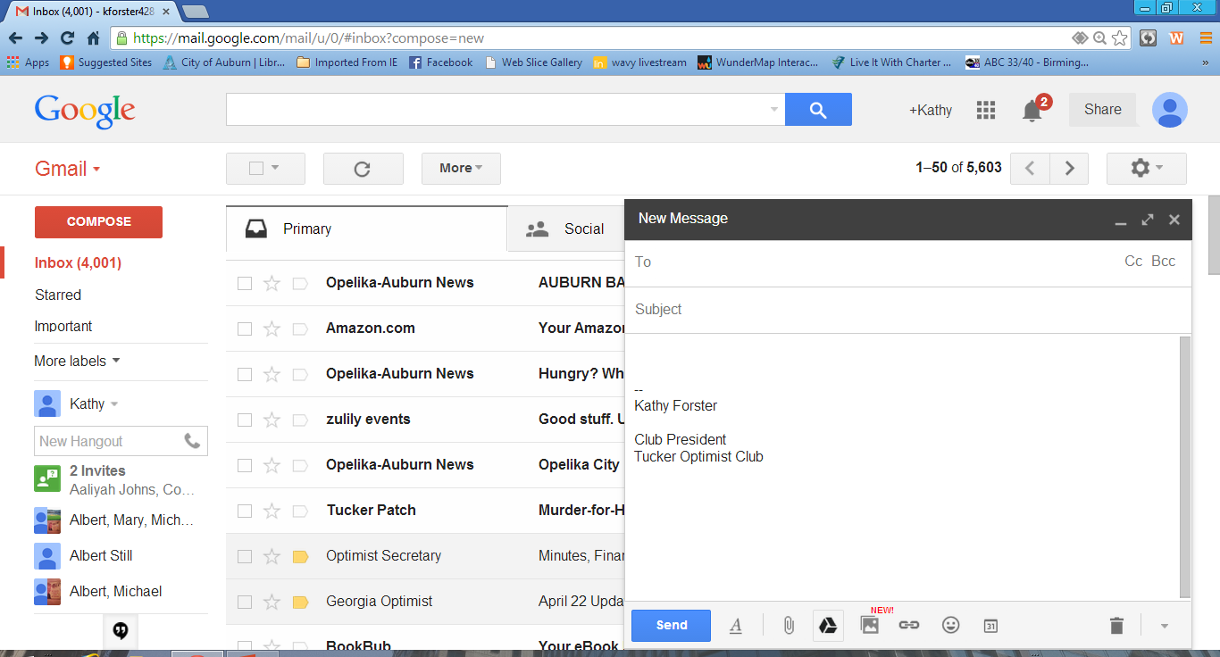

Slide 57
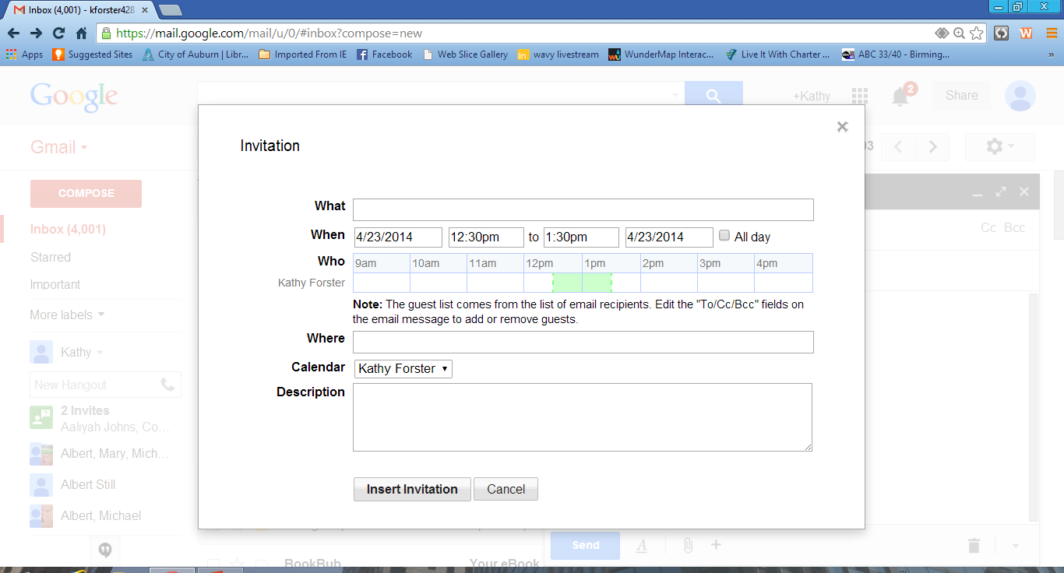

Slide 58
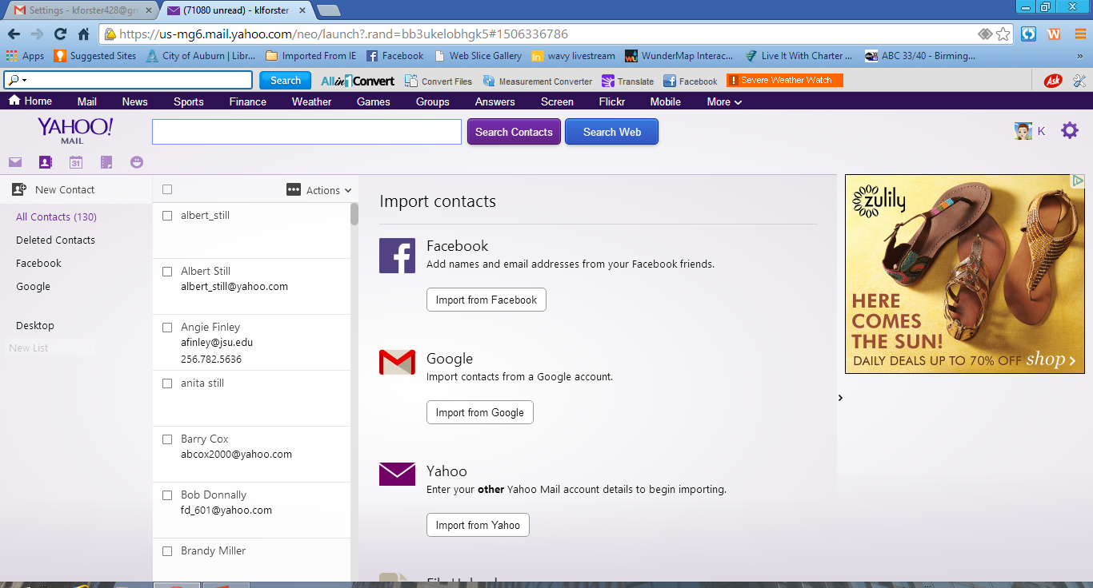

Slide 59
Forwarding an email
Cleaning an email to forward

Slide 60
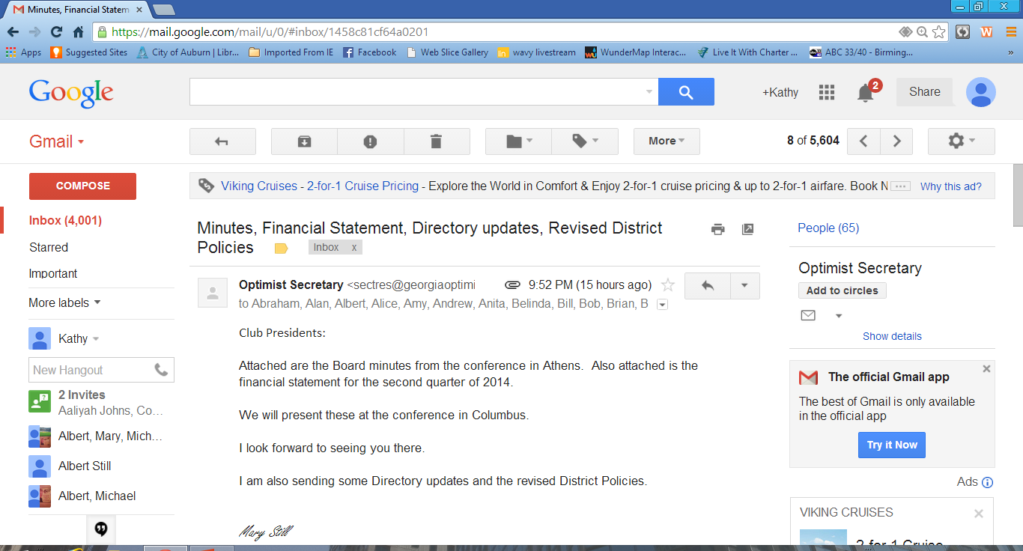

Slide 61
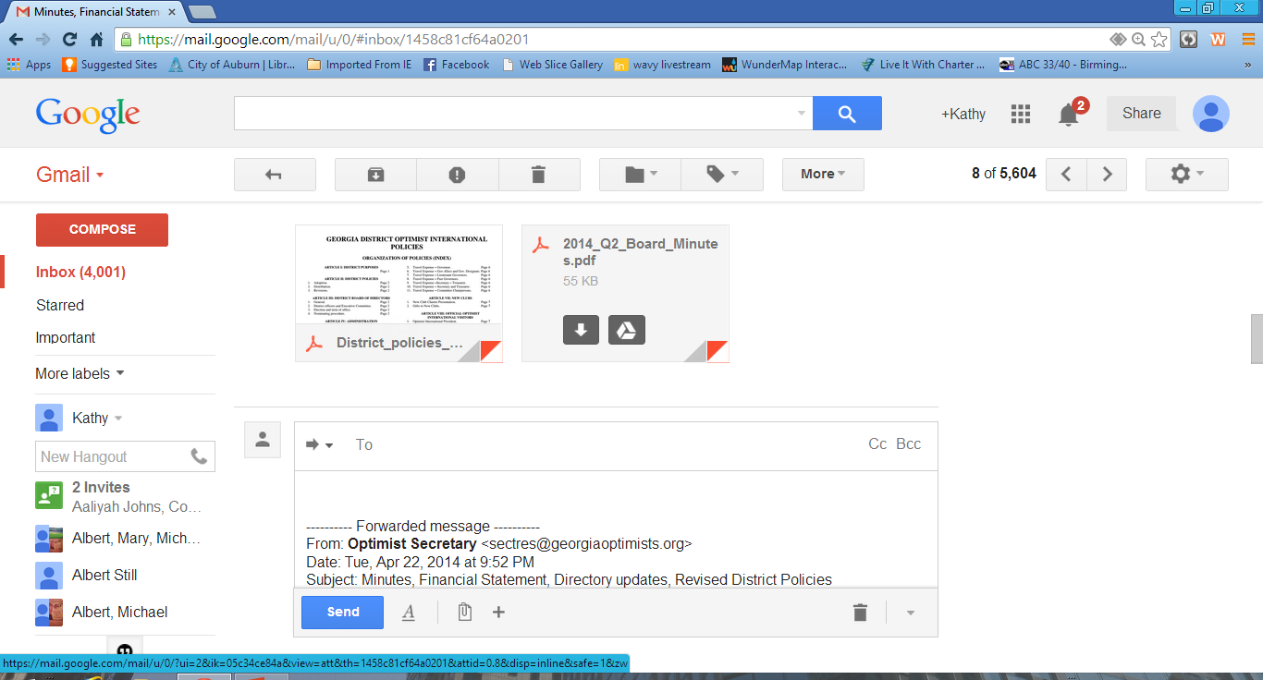

Slide 62
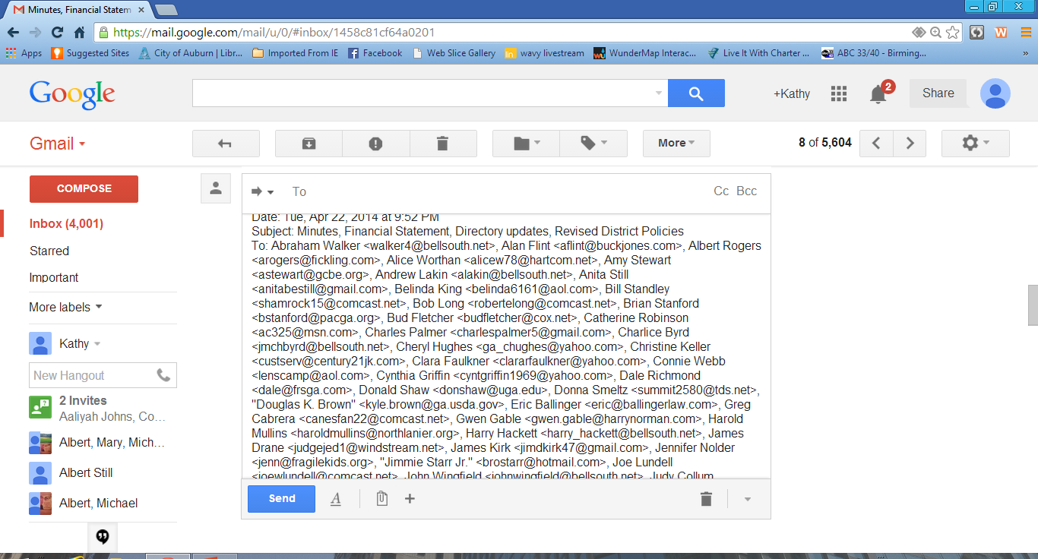

Slide 63
Highlight all names and email addresses.
Right Click and select delete.

Slide 65
Email etiquette
What to do and not do

