Slide 1
Make It Count!
Track Your Club’s Impact
Notes:
Welcome everyone and thank you for taking the time over your lunch to join today.
My name is Amy Keller, and I’m part of the Youth Programs Department at Optimist International.
We know that Optimist Clubs are doing incredible work in their communities every single day—supporting youth, running programs, and making a real impact. The purpose of today’s session is to make sure that impact is seen, captured, and shared.
We’re going to walk through the Club Impact Report—what it is, why it matters, and how simple it is to use—so that every project your club is doing can be part of the bigger Optimist story. After the presentation, we will open up for any questions.

Slide 2

Every Project Tells a Story…
Notes:
Clubs are doing incredible work every day—work that truly makes a difference.
But if it’s not reported…we can’t fully tell that story.
And that’s why this matters—because your reporting is what allows us to show the full impact of Optimist Clubs around the world.
It’s how we turn individual projects into a collective impact story.

Slide 3

Why it Matters
Show service hours and youth reached
Demonstrate impact to donors
Support funding and growth
Share your club’s story
Notes:
First, it helps us show the full scope of our impact—how many service hours our clubs are contributing and how many people we’re reaching. That’s something we simply can’t capture without your input.
It also allows us to demonstrate real impact to donors and partners. When we can show measurable results, it builds trust and opens the door for more support.
And that directly ties into funding and growth. The more clearly we can show our impact, the more opportunities we have to expand programs and support clubs like yours.
And finally, it helps share your club’s story. Every project you complete is part of a much bigger picture—and reporting is what allows us to highlight and celebrate that.

Slide 4
Club Project Reporting
Now submitted through the Club Impact Report
Replaces end-of-year Club Pride Report
Submit projects as they happen
More accurate and easier to manage
Notes:
Club Project reporting now happens through the Club Impact Report, instead of being submitted at the end of the year in the Club Pride Report.
So rather than trying to remember everything at the end of the Optimist fiscal year, you can submit projects as they happen.
It’s a simpler and more accurate way to capture your club’s impact.
So now that you know where this fits, let me show you how simple it is to submit.

Slide 5
How to Submit
1. Log into Optimist Leaders
2. Click 'Club Impact Report'
3. Enter details & submit
Officers submit (President, Secretary, Treasurer)
Notes:
Please note that only Club Officers can submit.
So once the club has completed a project, you can submit the details immediately.
First, you’ll log into Optimist Leaders (computer or phone)
From there, you’ll click on ‘Club Impact Report.’
Then you’ll enter a few details about your project (people served, volunteer hours, collaboration with other groups, other project details)
Then “Submit”

Slide 6
What Counts?
✨EVERYTHING COUNTS! ✨
SIGNATURE PROGRAMS
  Junior Optimist International (JOI)
  Junior Golf
  Optimists Working for Learning Success (OWLS)
  Essay, Oratorical, CCDHH
COMMUNITY PROJECTS
  Park cleanups, fundraisers, food pantries, respect for law, visual arts,
Notes:
Everything your club does counts!
That includes all of our Signature Programs — Junior Optimist International, Junior Golf, Optimists Working for Learning Success (OWLS), Essay, Oratorical, and CCDHH.
But it’s not just those Signature Programs—ALL community projects count – park cleanups, fundraisers, food pantries, respect for law, visual arts, fishing derby, avenue of flags…
Whether it’s a small local effort or a larger program, if your club is making an impact, it should be reported.

Slide 7
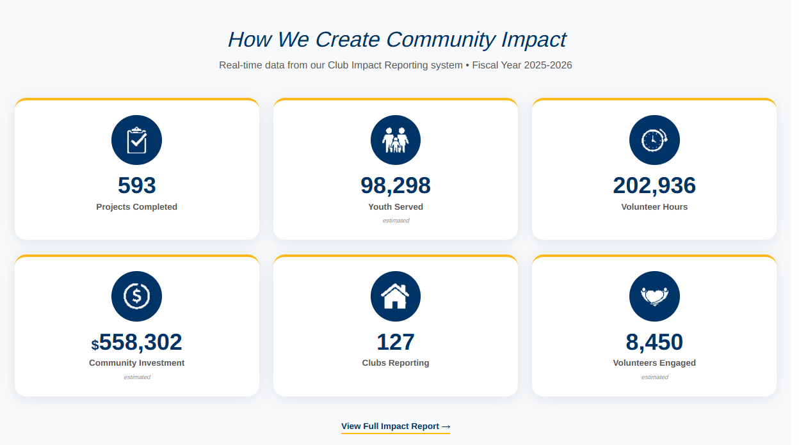
Your Impact, In Real Time!
Notes:
One of the biggest benefits of this new system is that your impact is visible in real time. All data is now displayed on the optimist.org homepage through a live counter, so as projects are submitted, you can actually see that impact grow. There’s also a full impact report available that shows the broader picture across all clubs.
At the same time, individual club reports can be accessed through Optimist Leaders, allowing clubs to view their own data at any point throughout the year. So this isn’t just about submitting information—it’s about making your impact visible at every level, from your local club to the global organization.

Slide 8
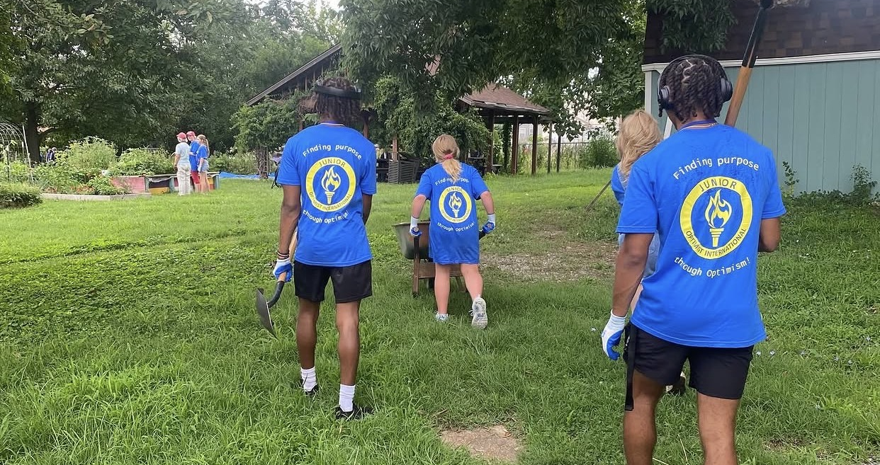
Questions?

